Slide 1
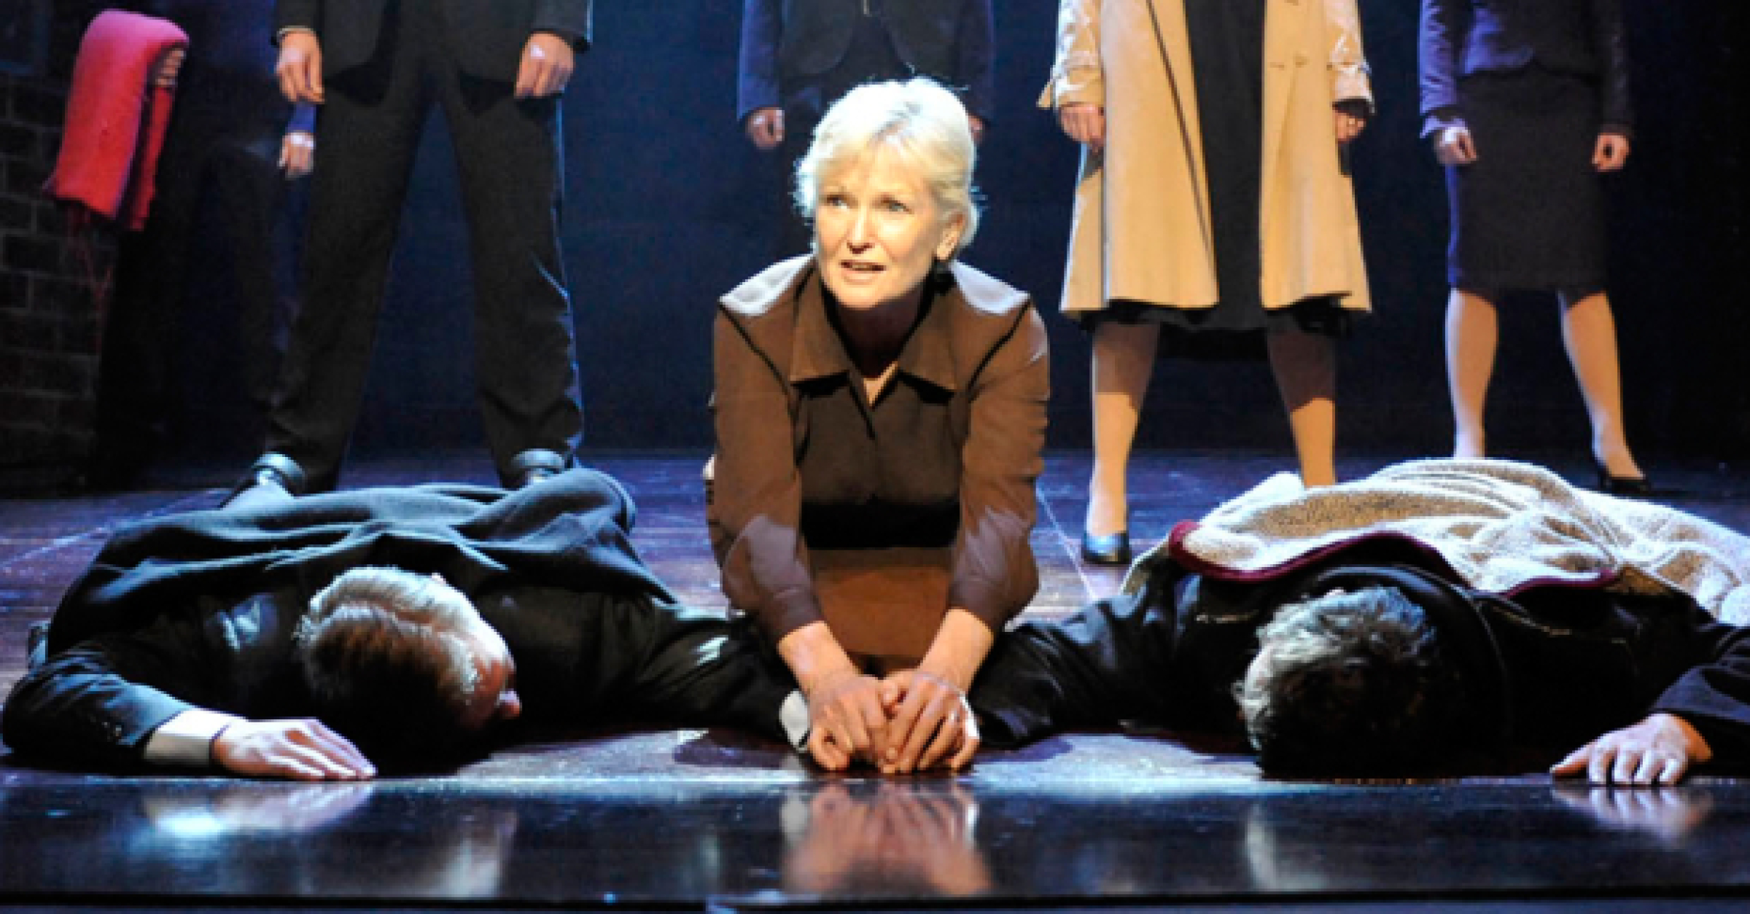
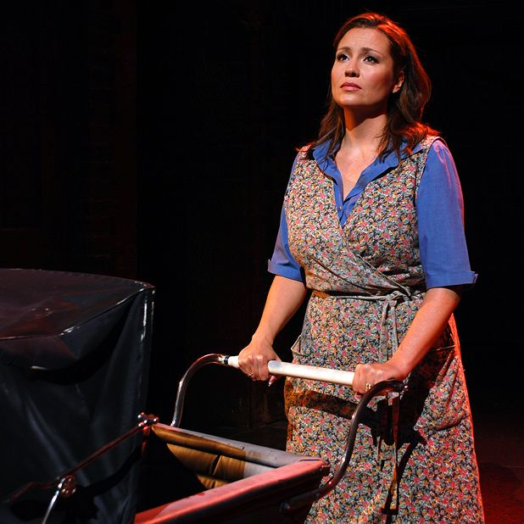
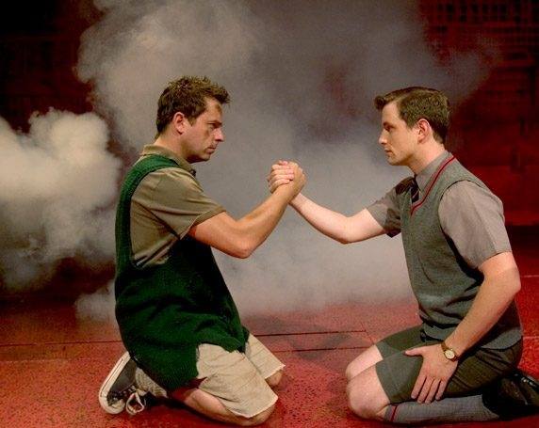
Knowledge Organiser – Drama
Blood Brothers by Willy Russell – KS3
Set from 1960 – 1980
In Liverpool, England
.
Key Themes
Childhood Adolescence
Superstition
Violence
Nature Vs Nurture
Social Class

