Slide 1
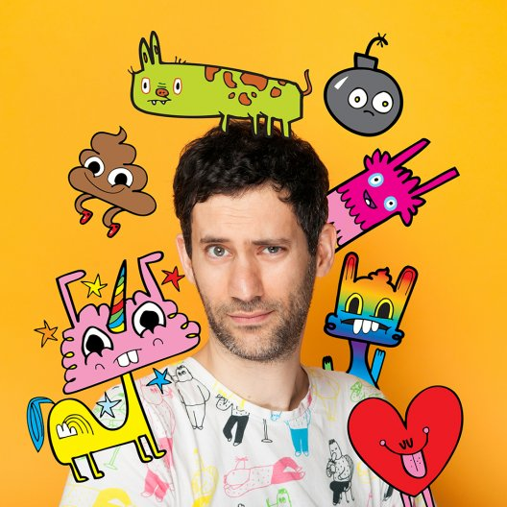
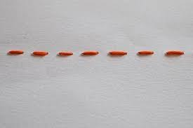
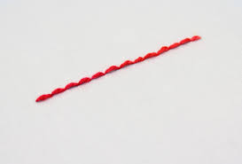
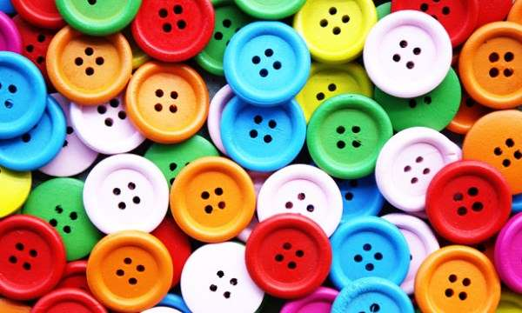
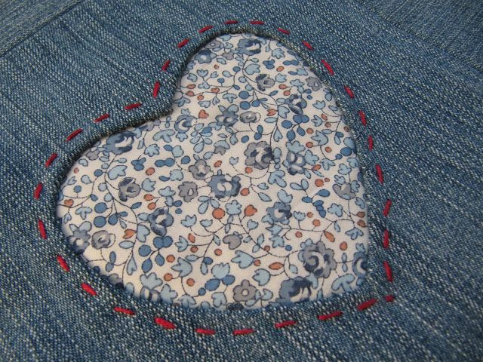
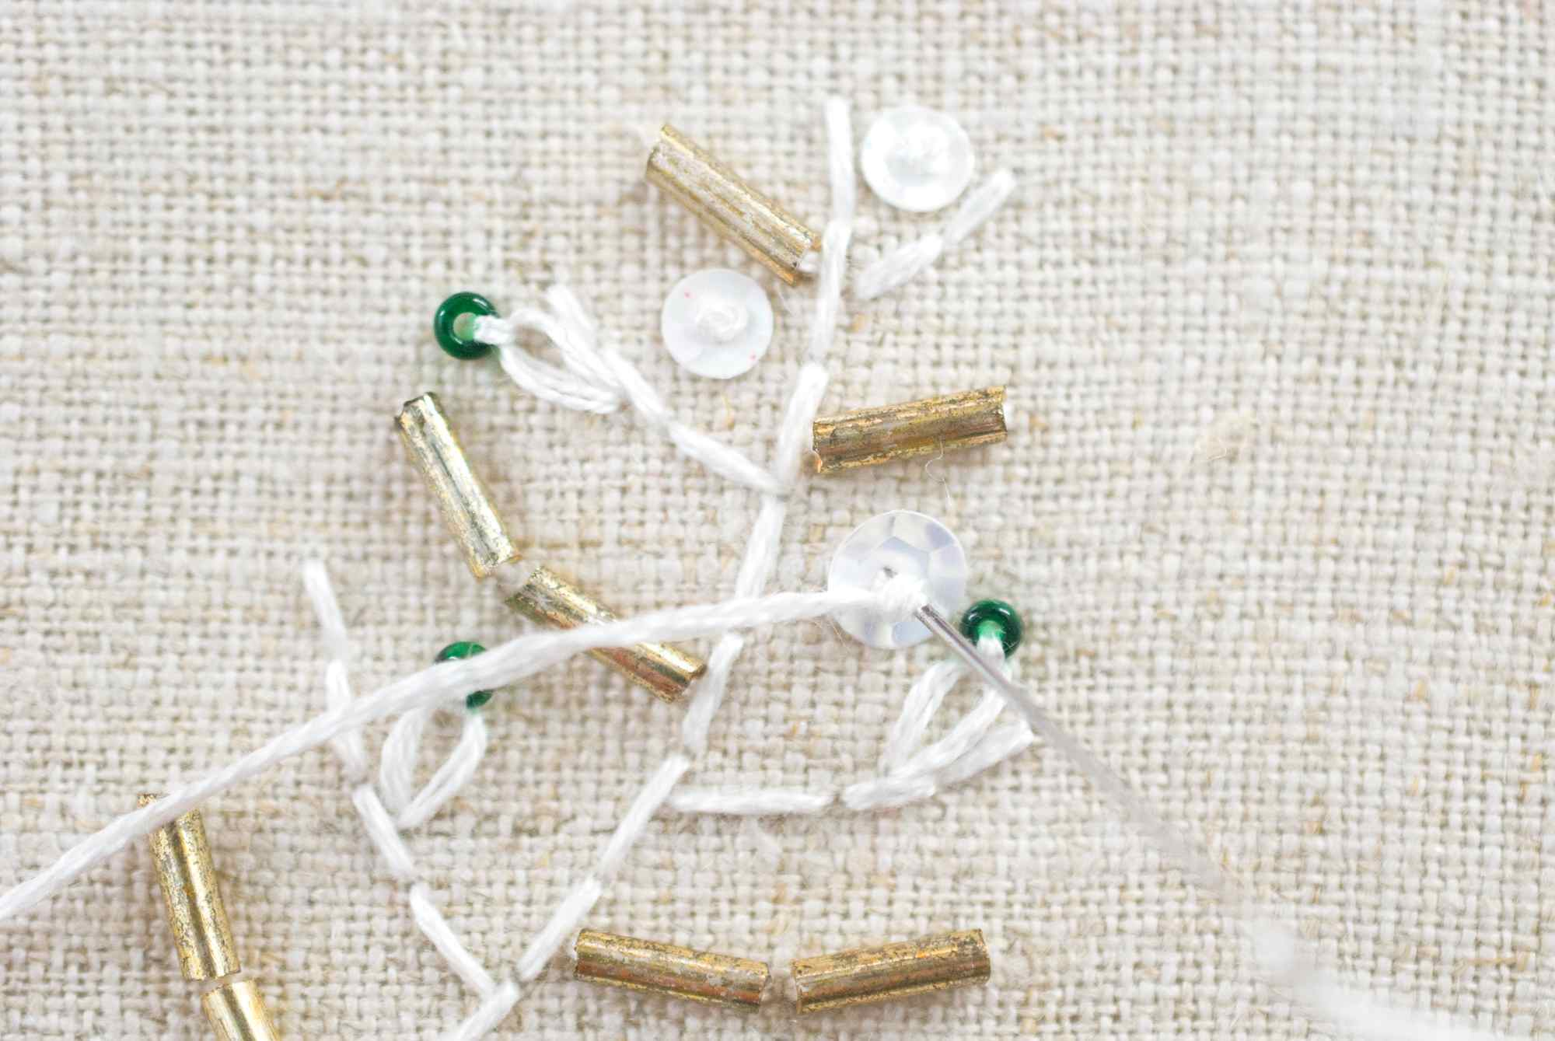
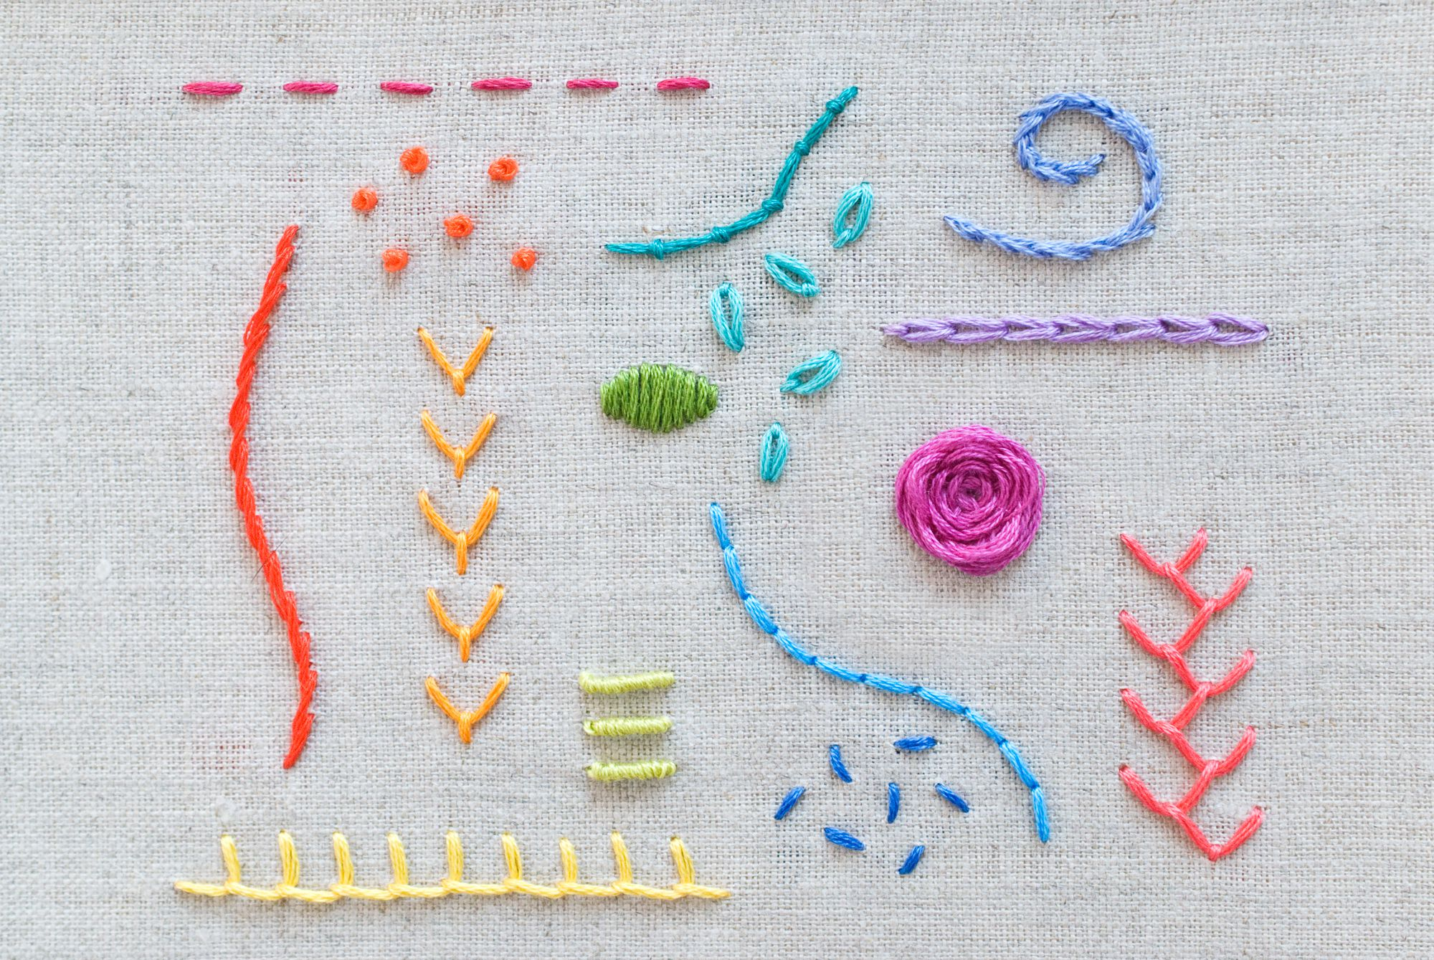
Year 7 Textiles Knowledge Organiser
Project overview
During this project you will further develop your skills and knowledge in textiles by responding to a design brief and designing and making a hand puppet inspired by the work of Jon Burgerman.
Running stitch
Back stitch
Applique
Buttons
Key knowledge and skills
How to read and respond to a design brief.
How to develop designs and annotate (a note by way of explanation or comment added to a design).
How to cut using fabric scissors.
How to thread a needle and tie a knot.
Running stitch.
Back stitch.
How to add applique.
How to sew a button.
Jon Burgerman:
Jon Burgerman is a contemporary British-born NYC based graphic designer and artist. He is one of the leading doodle artists, credited for his innovative 'Doodle' art style. Jon Burgerman creates doodles that examine his environment through the lens of humour. Considered the prominent practitioner of the art style, Burgerman draws on various sources, including his own wild imagination, to portray vivid characters with signature googly eyes.
Extension tasks and challenging activities
Reverse applique
Sequin or bead
Decorative stitches
Health and safety
Hazard: A danger or risk
Mitigate: To lower the risk.

Slide 2
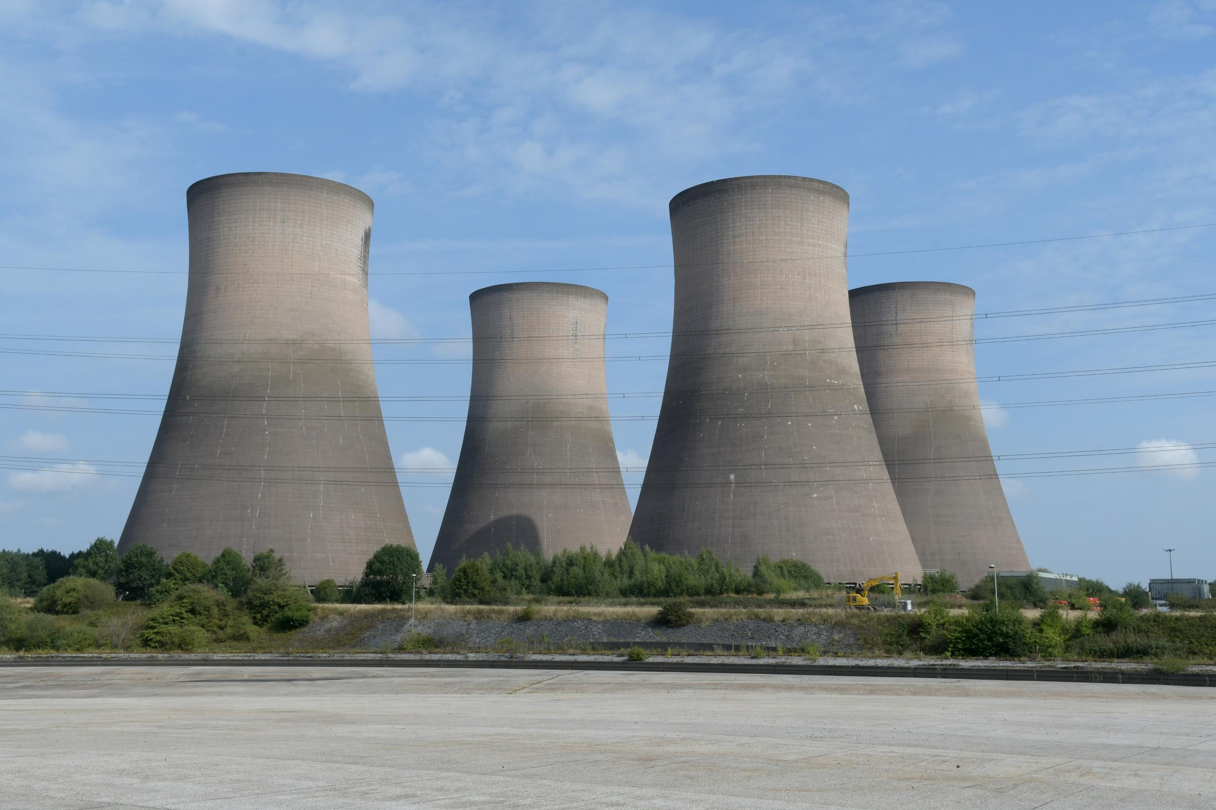
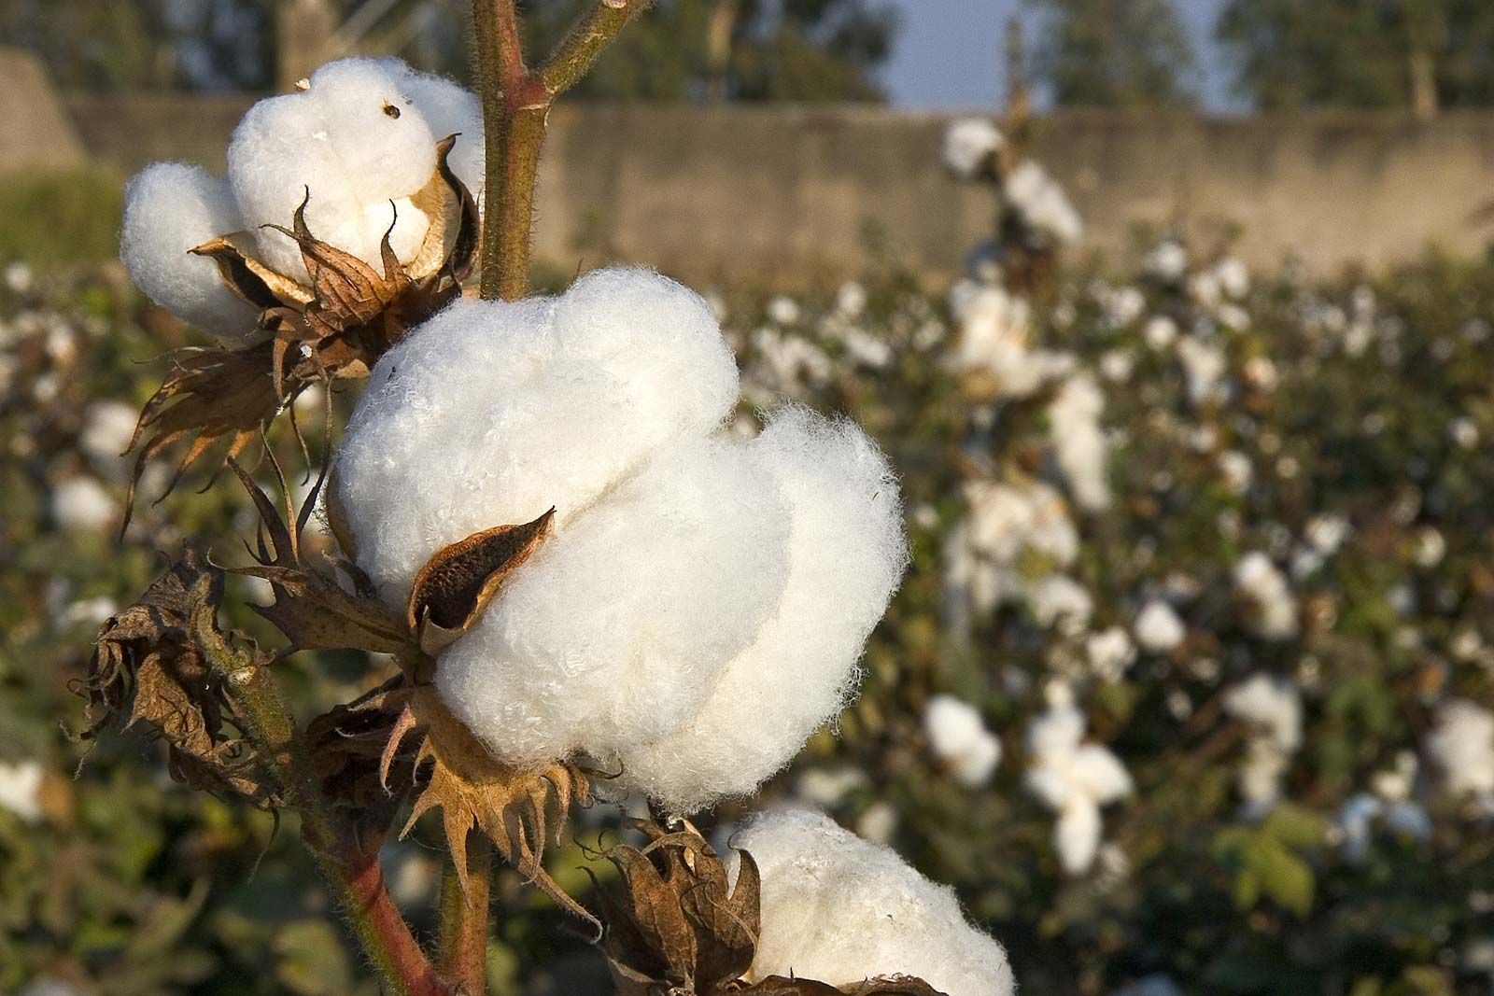
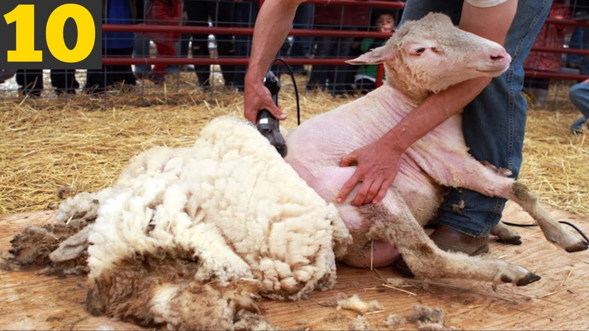
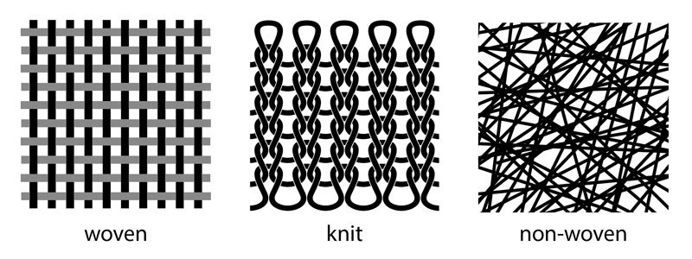
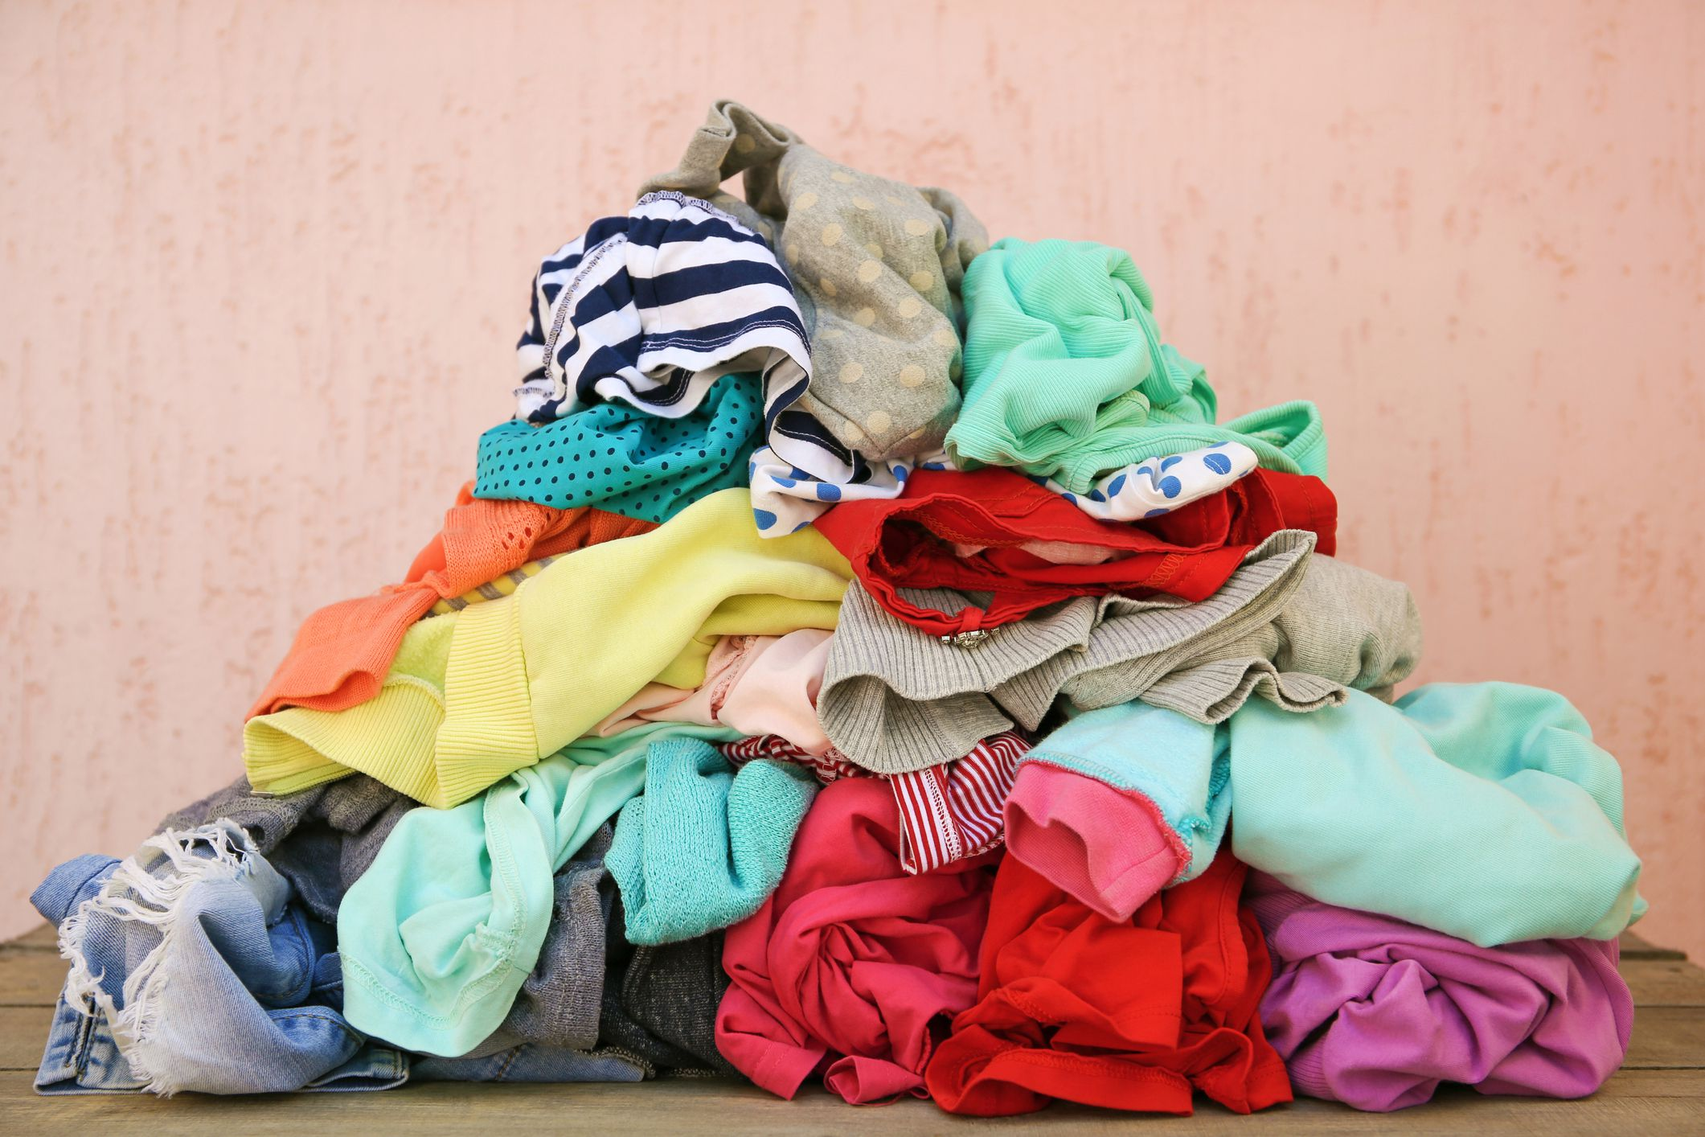
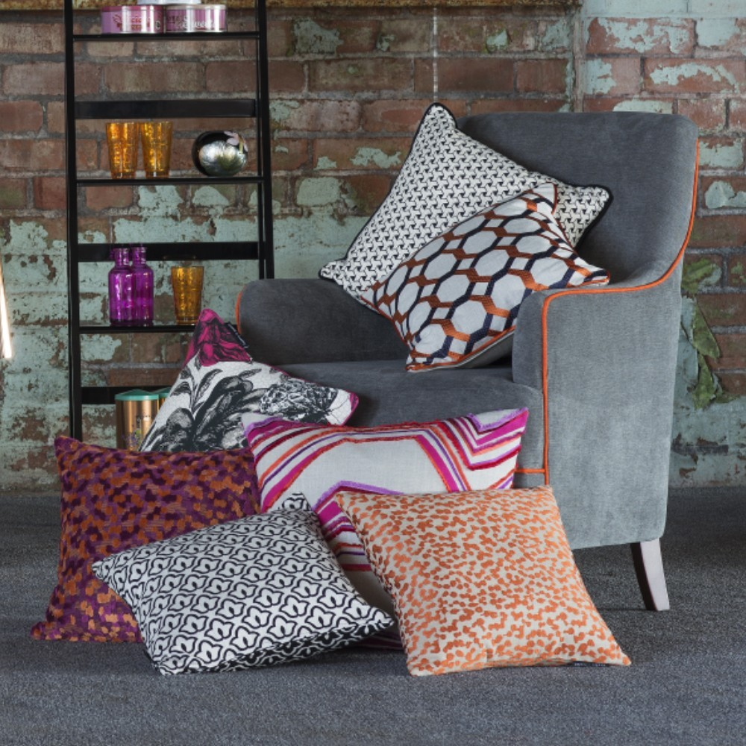
1: Fabrics can come from an animal, plant or man-made source.
Materials that come from an animal source:
Wool (sheep)
Silk (silkworm)
Mohair (Angora goat)
Cashmere (Cashmere goat)
Camel Fibre (Camel)
Alpaca Fibre (Alpaca)
Materials that come from a plant source:
Cotton (cotton plant)
Linen (flax plant)
Jute (jute plant)
Bamboo Fibre (Bamboo)
Sisal Fibre (sisal plant)
Materials that come from a man-made source:
Polyester
Spandex
Nylon
Acrylic
Polyurethane
Neoprene
Rayon
2: Fabrics are made by weaving, knitting or felting together fibres.
Key words:
Textiles: Textiles are materials that are made by weaving, knitting or felting fibres.
Design Brief: A design brief is a document for a design project developed by the designer or design team in consultation with the client/customer. The document outlines key information such as the target audience and design features.
Annotation: A note by way of explanation or comment added to a design.
Felt: Felt is a bonded fabric which is made up of webs of fibres bonded together through heat or by adhesive.
Applique: Applique is ornamental needlework in which pieces of fabric are sewn or stuck on to a larger piece to form a picture or pattern.
Stitching: Stitching is the movement of a threaded needle through fabric using a stitch such as a running stitch or a back stitch.
Seam Allowance: A seam allowance is the area between the fabric edges and the line of stitches.
Embroidery: To embroider means to decorate with needlework.
Felt: Felt is a bonded fabric which is made up of webs of fabrics bonded together through heat or by adhesive.
3: Once woven, knitted or felted they can then be made into a textile product.

