Slide 1
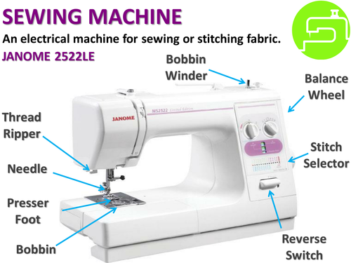
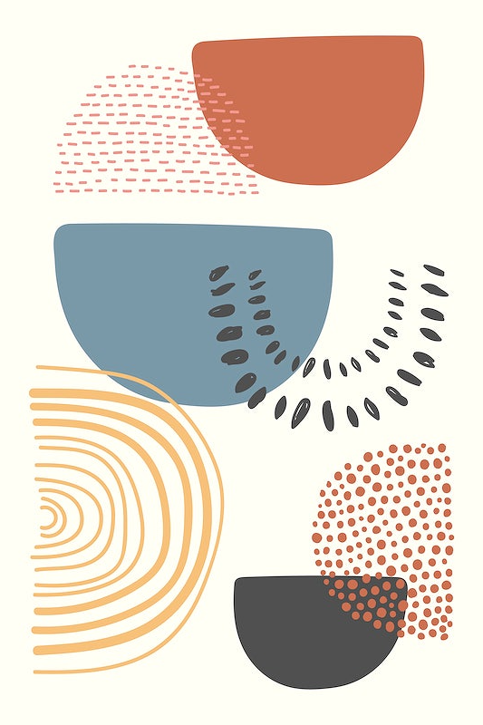
Year 9 Textiles Knowledge Organiser
Project overview
During this project you will further develop your skills and knowledge in textiles by responding to a design brief and designing and making a wall hanging inspired by the work of Melanie Bowles.
Key knowledge and skills
How to read and respond to a design brief
Knowledge of specialist equipment and how to use it safely
Understanding of how to safely operate a sewing machine
Develop oracy skills (speaking and listening skills) using key words and definitions
Craft knife skills
Embroidery skills
Careers within Textiles
Trend forecaster
Buyer
Visual merchandiser
Fashion designer
Print designer
Interior designer
Tailor
Teacher
Stylist
Textile operative
Upholsterer
Costume designer
Textile Technologist
Pattern cutter
Health and safety
Hazard: A danger or risk
Mitigate: To lower the risk

Slide 2
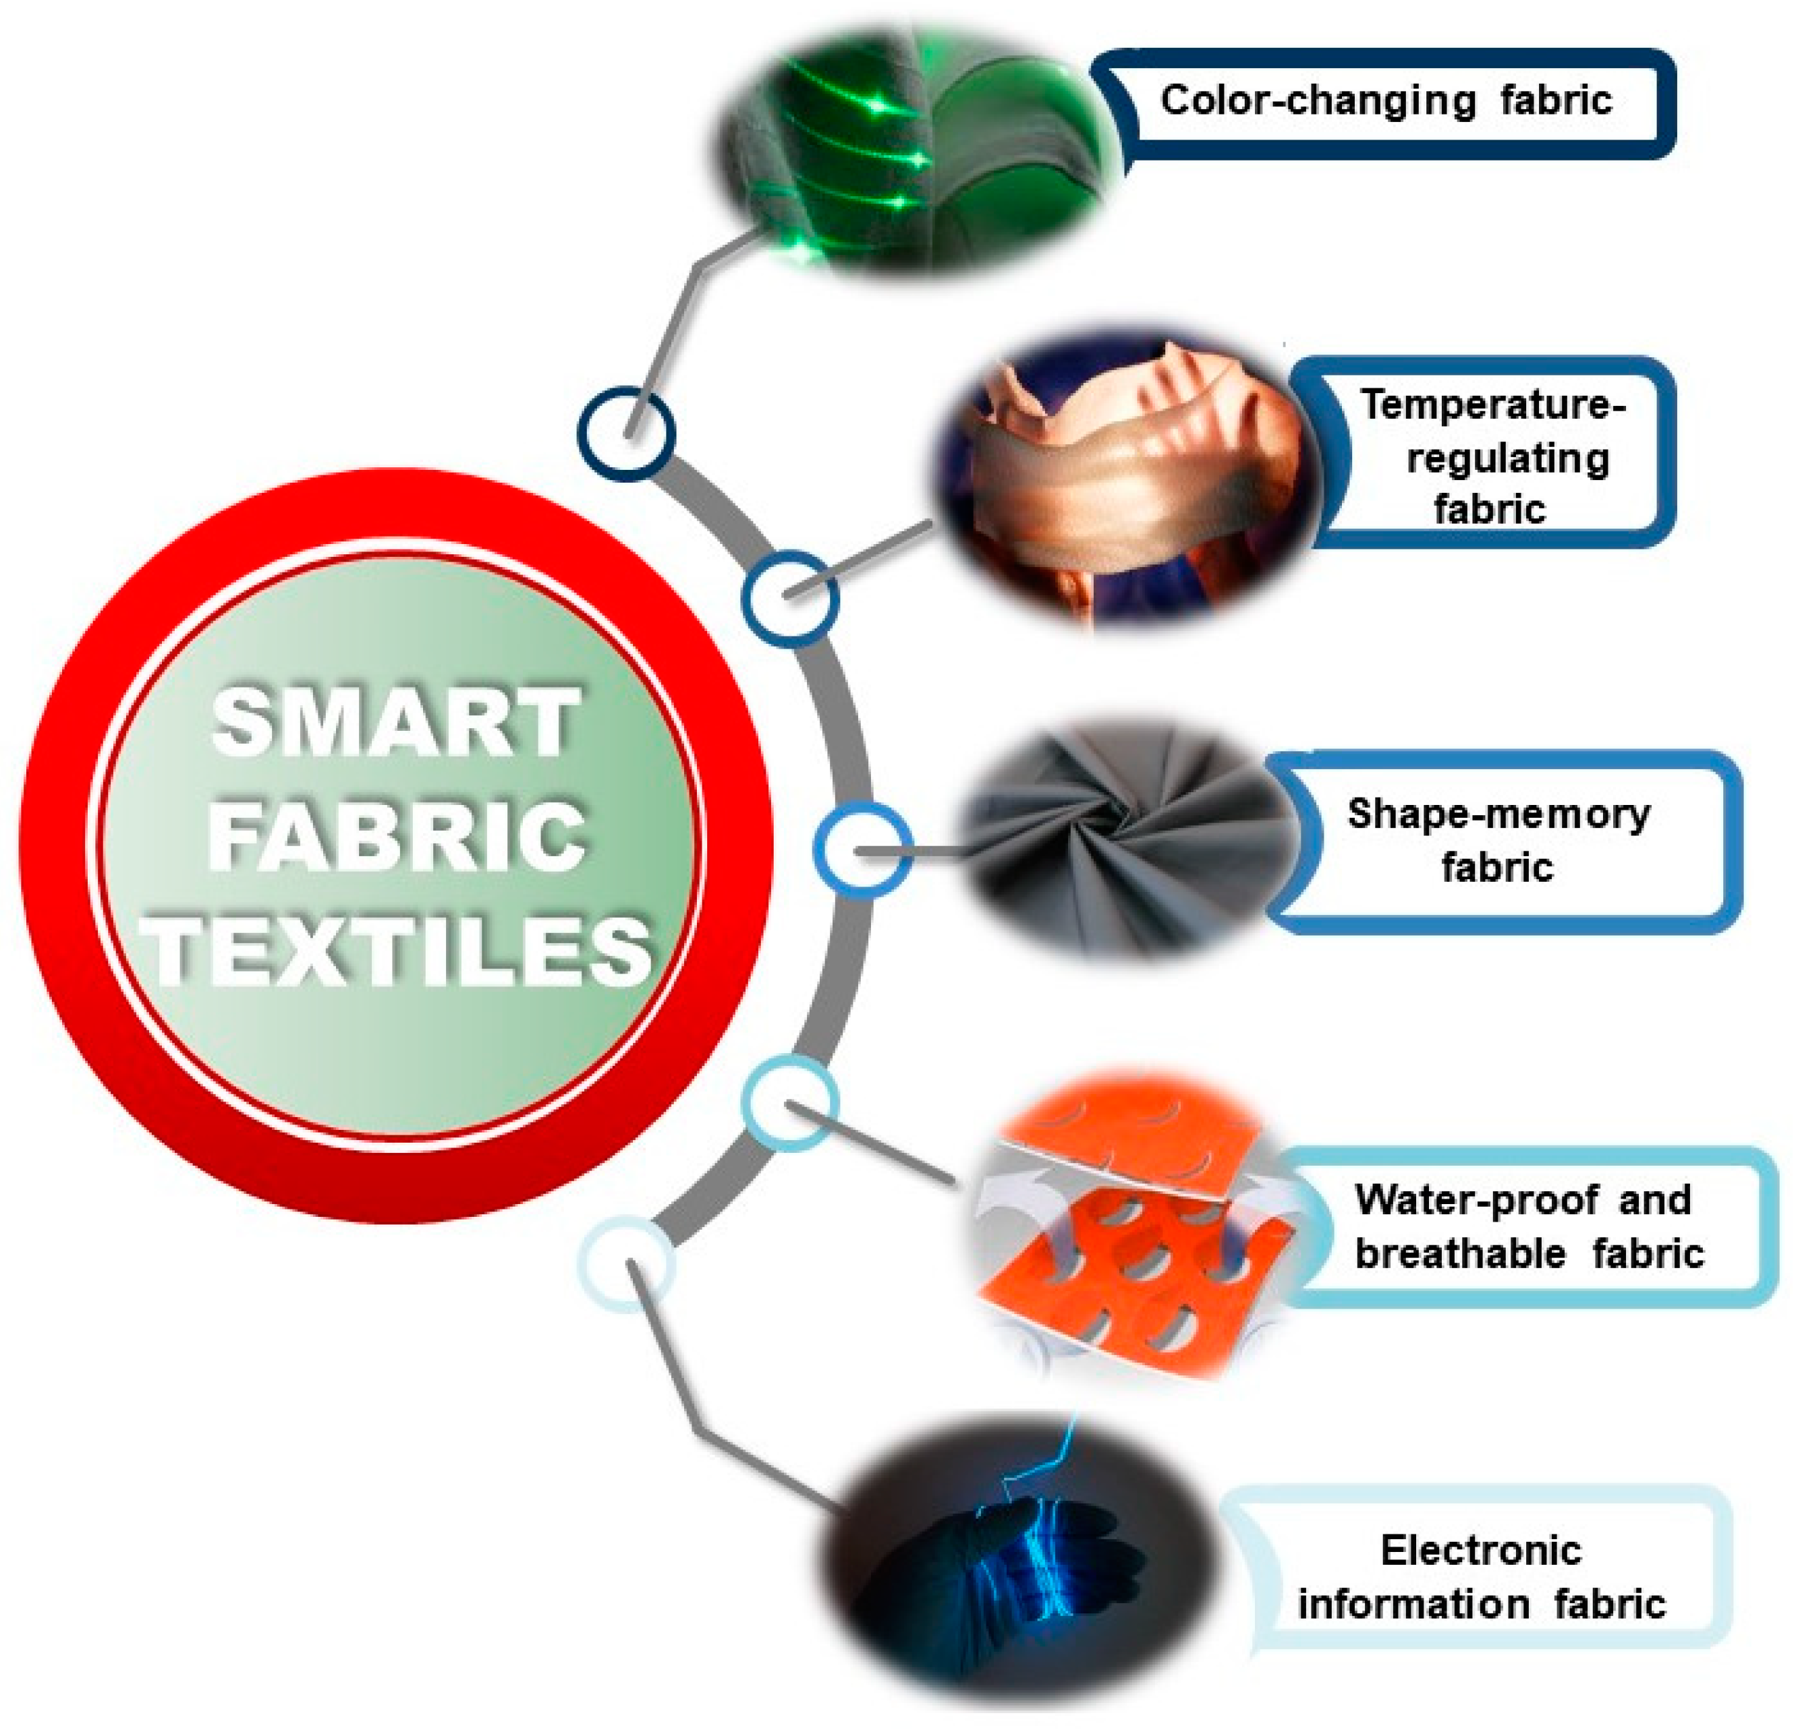
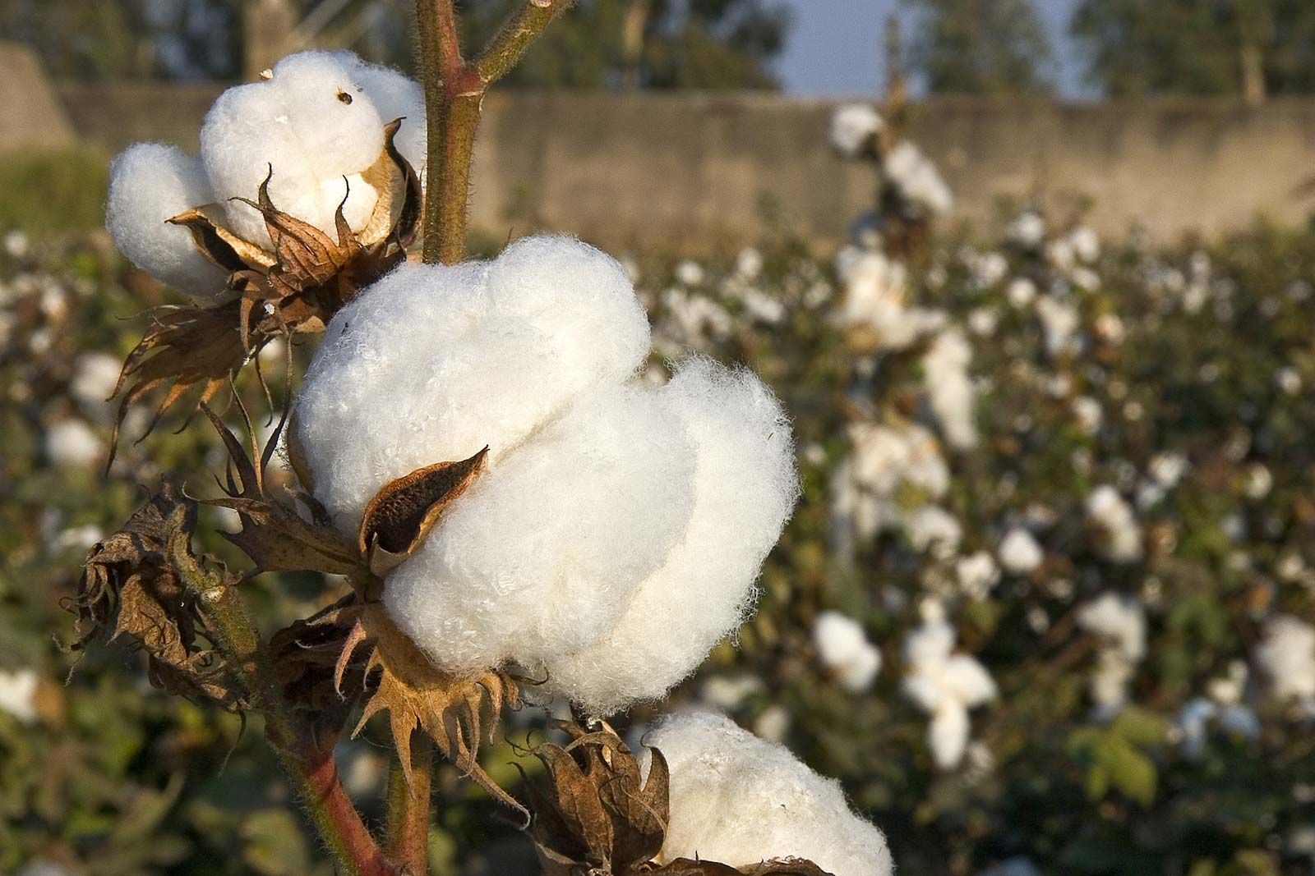
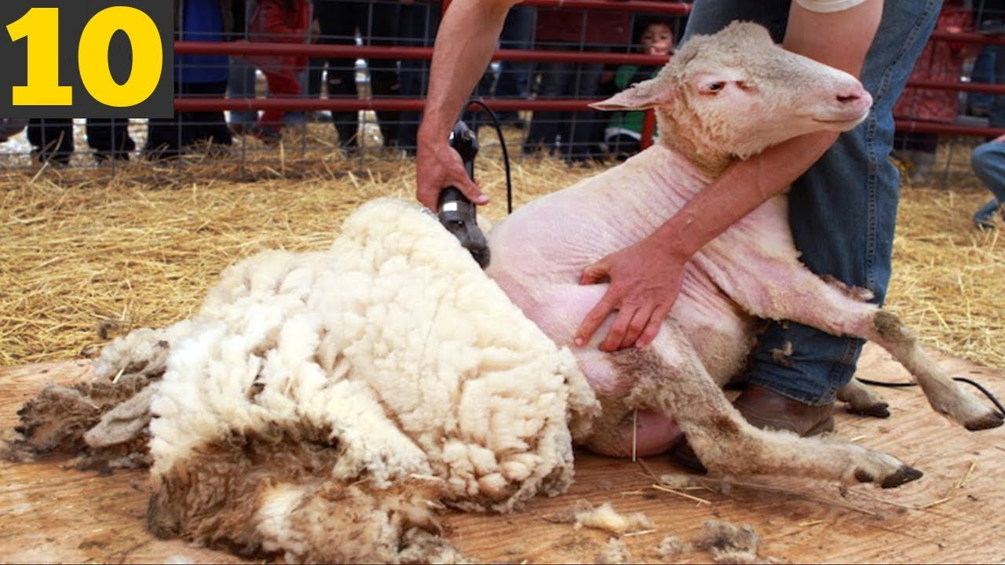
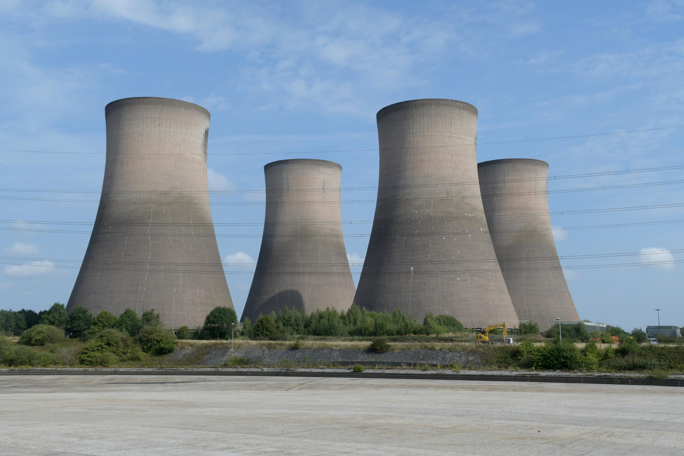
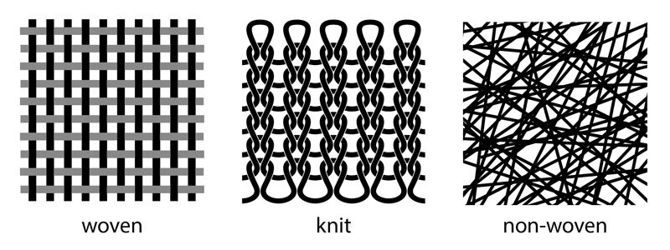
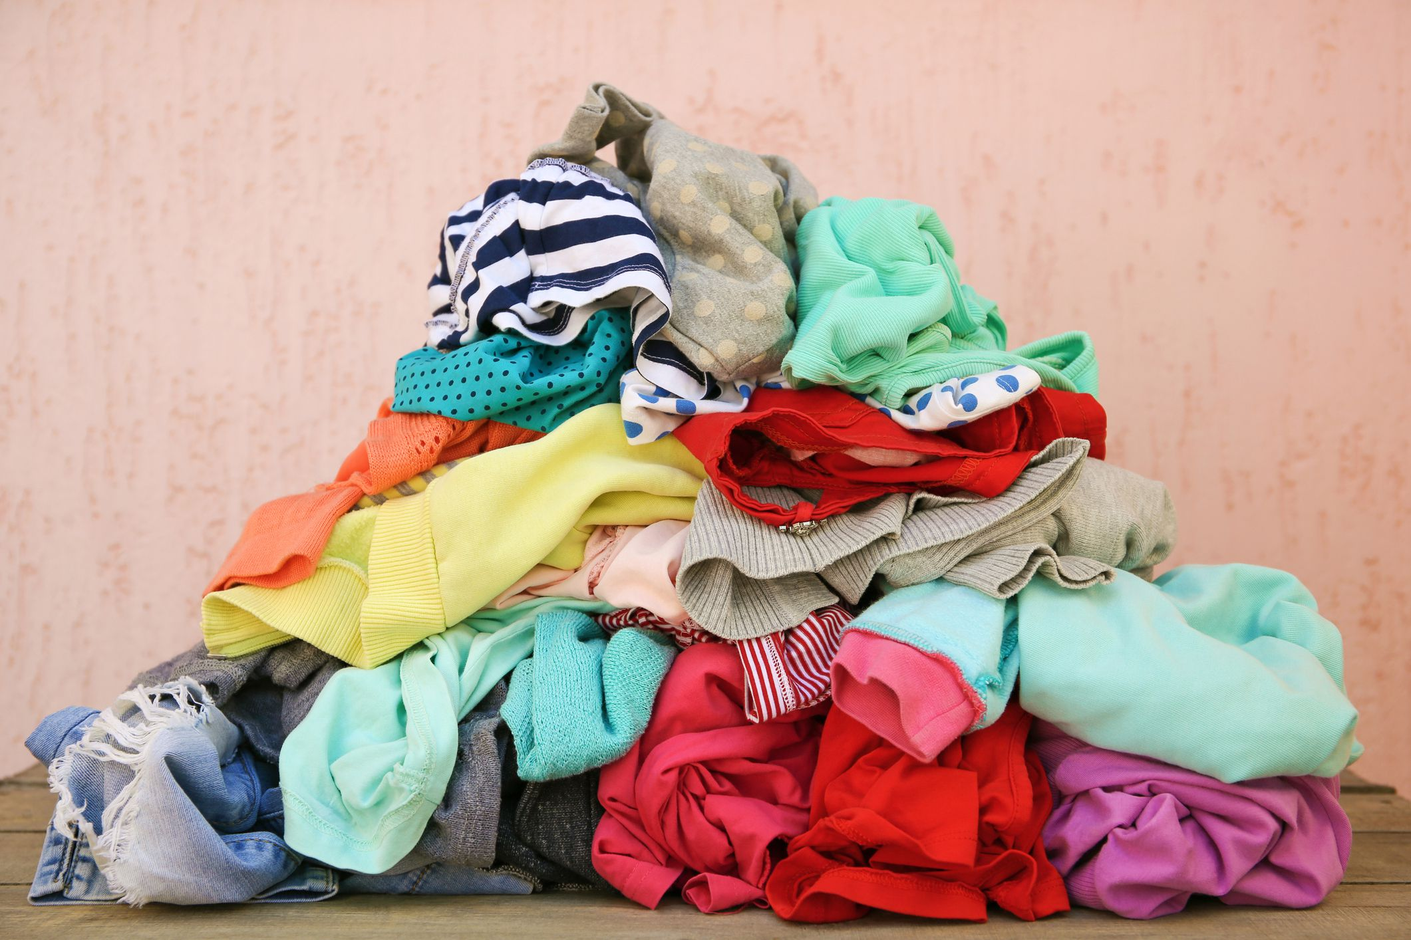
Smart materials can sense changes in the environment. Here are some examples:
photochromic dyes can make fabric able to change when exposed to UV light. This is used in sun bracelets to warn the wearer that they have been in the sun for too long.
reactive materials react to changes, such as loss of heat. These are used in sportswear or in safety clothing.
phase changing materials to help regulate body temperature, these are used in hiking equipment for extreme environments
Where do fabrics come from?
1: Fabrics can come from an animal, plant or man-made source.
2: Fabrics are made by weaving, knitting or felting together fibres.
3: Once woven, knitted or felted they can then be made into a textile product.
Key words
Melanie Bowles: Is a practicing textiles designer and senior lecturer at Chelsea college of Art.
Stencilling: The method of repeating a design through a cut-out shape is called stencilling.
Smart material: Smart materials, are designed materials that have one or more properties that can be significantly changed in a controlled fashion by external stimuli, such as moisture, light or temperature.
Textile Fibres: Textile fibres are natural or synthetic structures that can be spun into yarn and woven, knitted, or bonded into fabric.
Abstract: Abstract art is art that does not attempt to represent an accurate depiction of a visual reality but instead uses shapes, colours, forms and gestural marks to achieve its affects.
Design Brief: A design brief is a document that defines the core details of a design project. It needs to define what you, as the designer, need to do, and within what constraints e.g. time frame, target audience etc.
Embroidery: the art or process of forming decorative designs with hand or machine needlework.
Applique: The craft of sewing one piece of fabric to another to form a picture or a pattern.
Pattern: A repeated decorative design.
Equipment
Fabric scissors
Beads
Craft knife
Safety mat
Stencil card
Buttons
Cotton thread
Sewing needles
Iron
Cotton
Fabric paints
Embroidery needle
Embroidery thread

