Slide 1
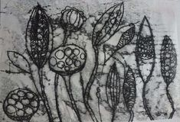
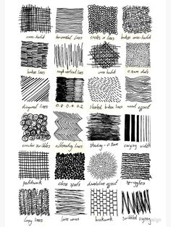
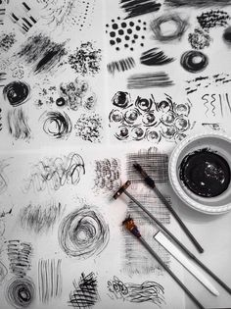
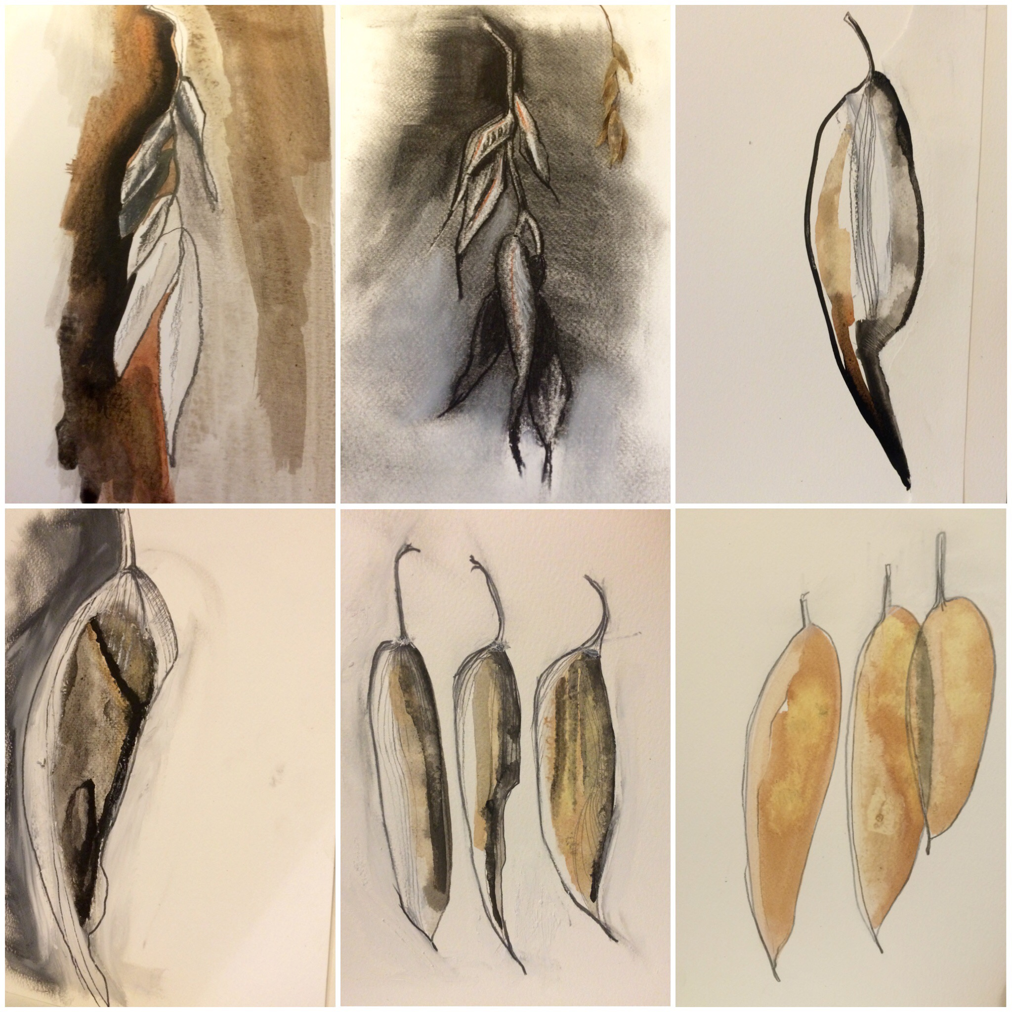
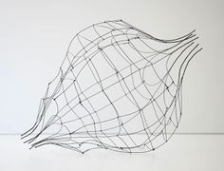
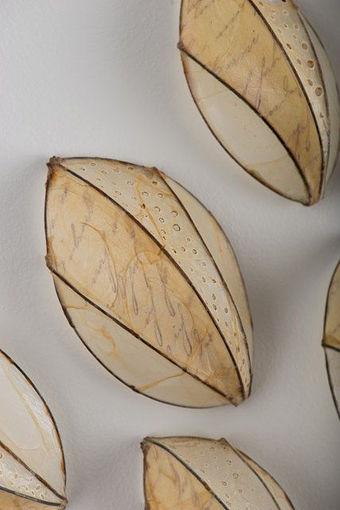
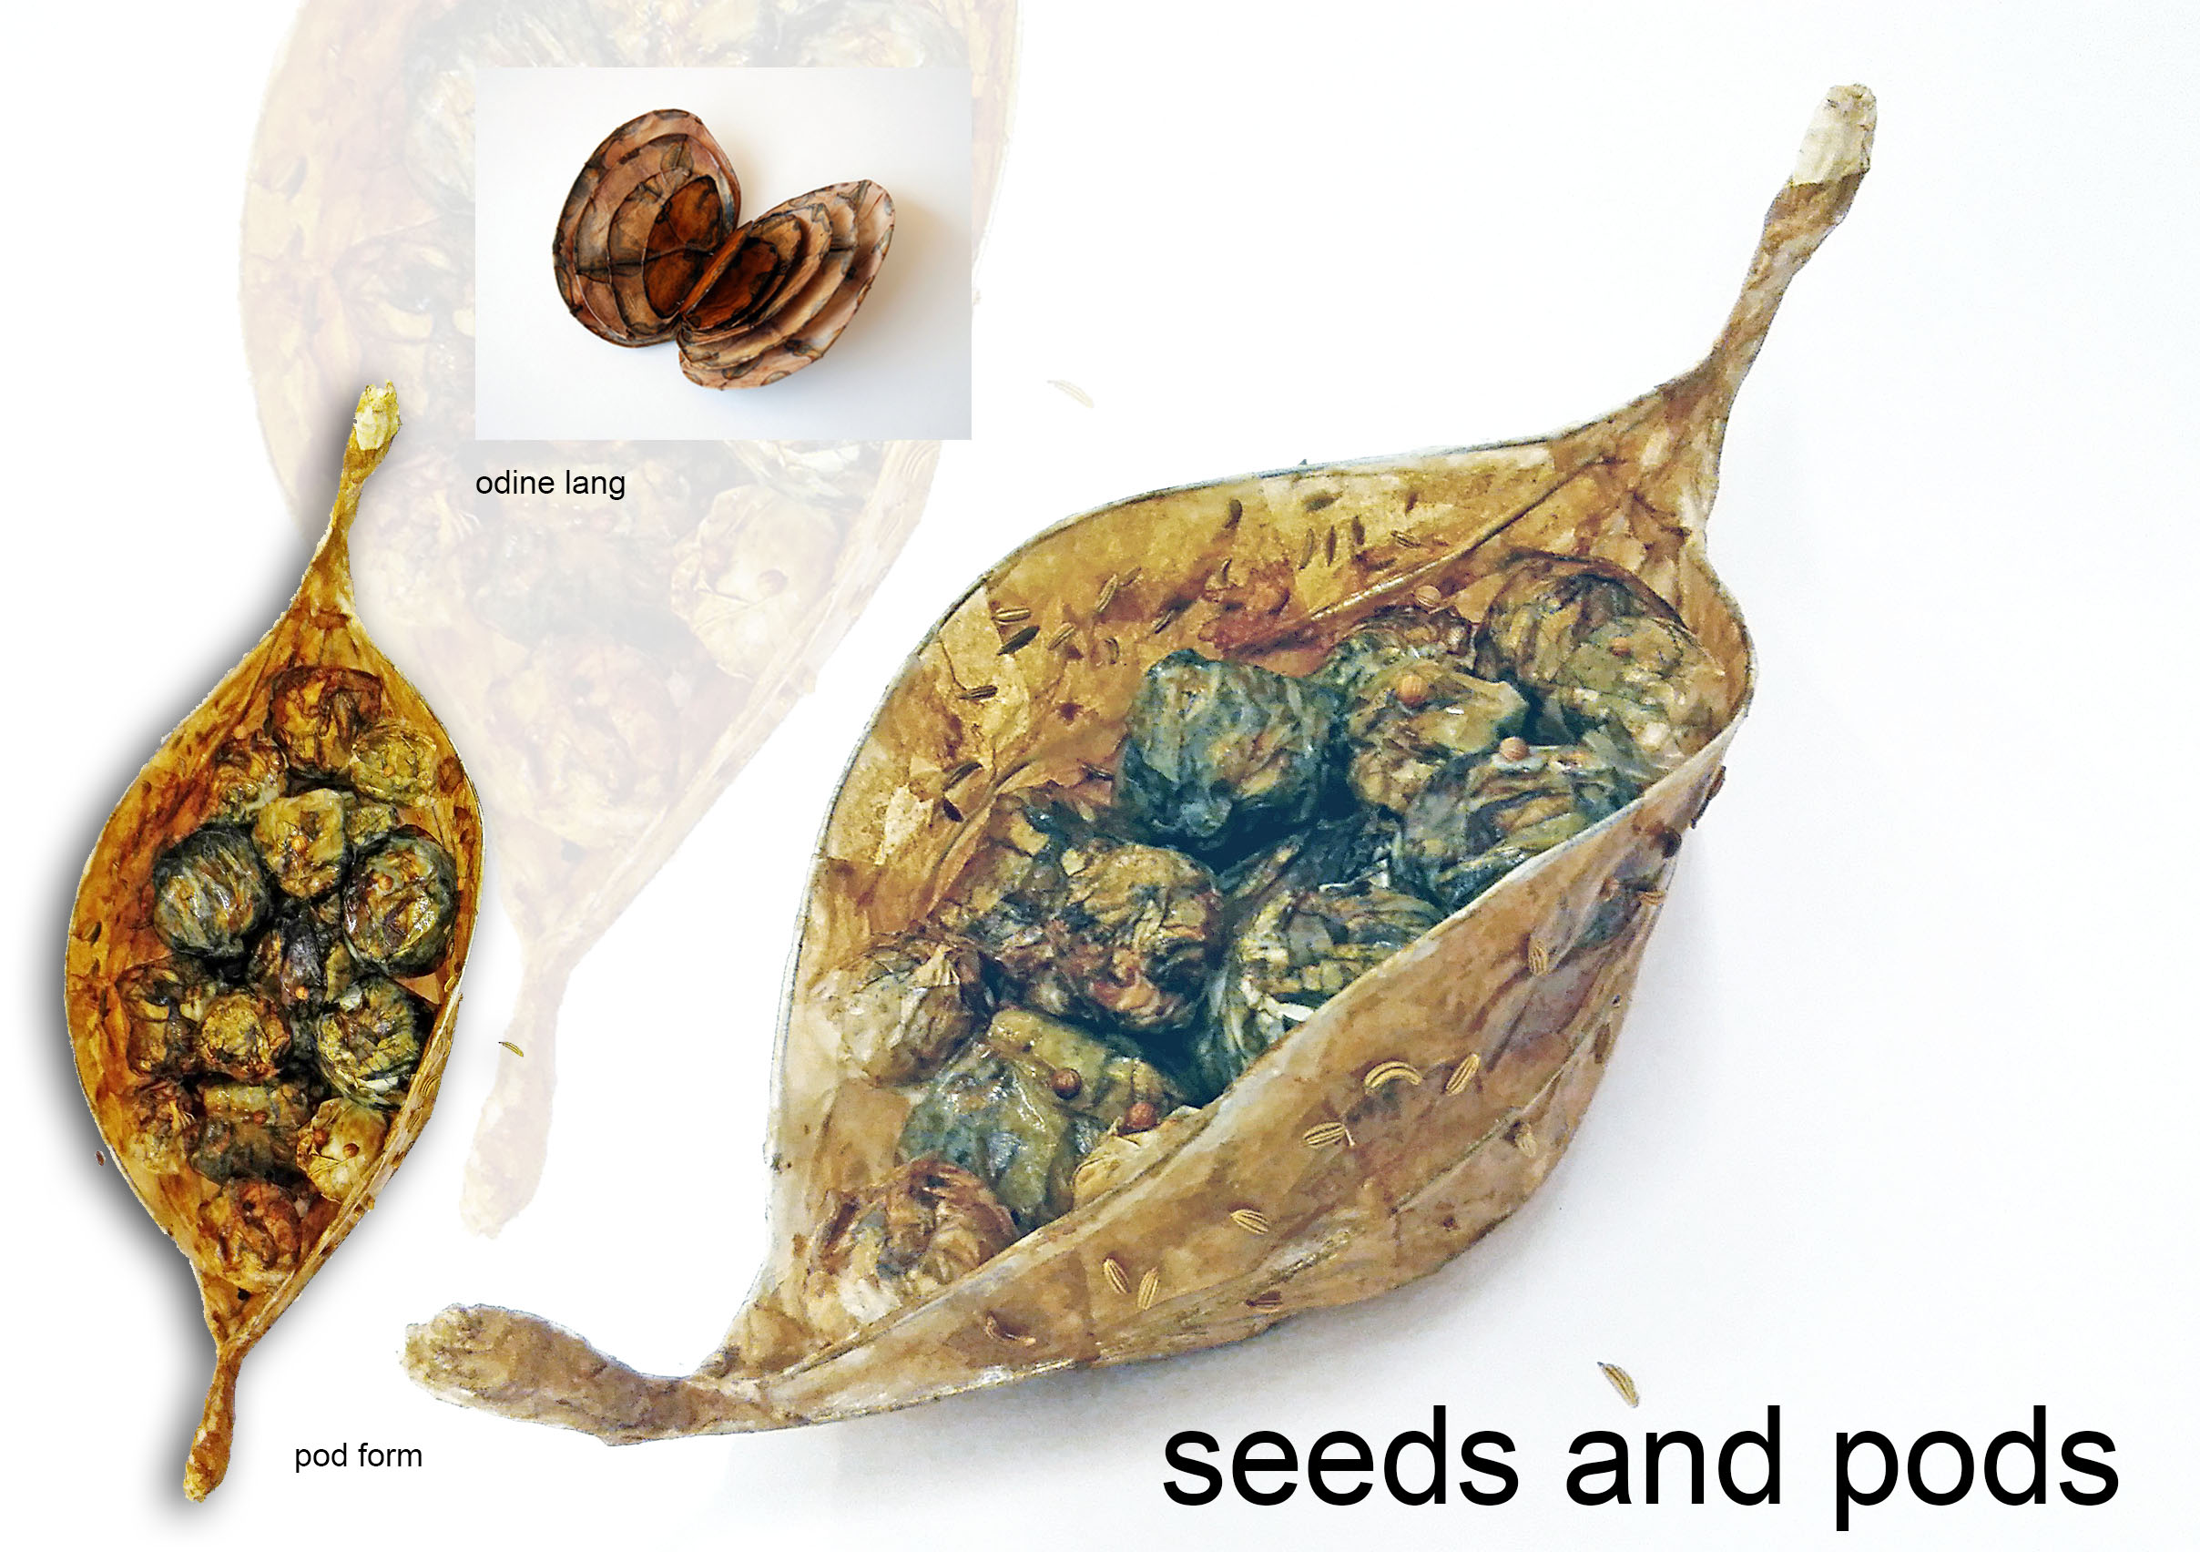
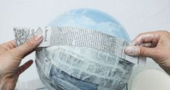
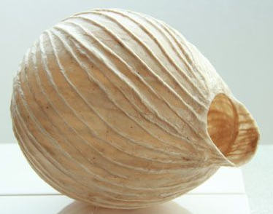
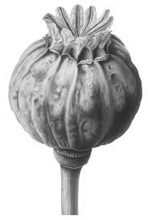
GCSE
Art & Design
Monoprinting
A technique which is known as the most painterly among printmaking as it is essentially printed painting. It has lines and images that can only be made once = MONO
Markmaking
To give your monoprints and drawings more interesting textures try to use a range of linear effects to represent different surfaces in the image. Do this by changing direction, pressure or length of mark or use different drawing tools such as pencils, biros, end of a brush
Assessment objectives
AO1 Understanding | Develop ideas through investigations, demonstrating understanding of sources
AO2 Creative Making | Refine work by exploring ideas & experimenting with appropriate media, materials, techniques & processes
AO3 Recording | Record ideas, observations & insights relevant to intentions as work progresses
AO4 Presenting | Present a personal and meaningful response that realises intentions & demonstrates understanding of visual language
These are the skills & the key information that you will need to know & use in your ‘Organic Forms’ Project
Colour Vocabulary
Tertiary colours – Primary + Secondary
Shades – Colours + black Tints – Colours + white
Harmonious – Colours from the same section on the colour wheel
Muted or subdued colour scheme – refers to colour with a low saturation. Greyed, dulled or desaturated.
Methods of Recording
Observational Drawing | Drawing from looking at objects in front of you
Secondary Source Drawing | Drawing from printed images or photos
Photographs | Using a camera/phone to record images observed
Sketches | Light, quick & basic drawings used as a starting point
3D Techniques
Wire Forms
Papier mâché
sketches
Key Terms
Media | The substance that artists use to make artwork
Materials | The same as media but it can include the basis for artwork eg canvas, paper, clay.
Processes | The creative journey of what you do to develop your artwork from beginning to end.
Techniques | The method, procedure or way that something is done eg drawing, painting or printing are all different techniques
Design | A plan for the construction of an object or the preliminary planning to solve any problems
Refine | To make small changes which improve the idea in some way. Adapt, modify, transform or correct your work.
Formal Elements of Art
COLOUR LINE TONE
TEXTURE SHAPE PATTERN
FORM
Tonal shading

Slide 2
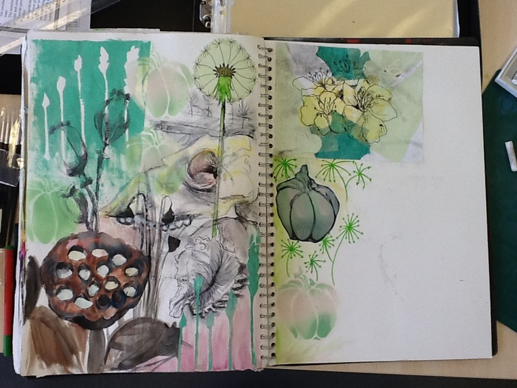
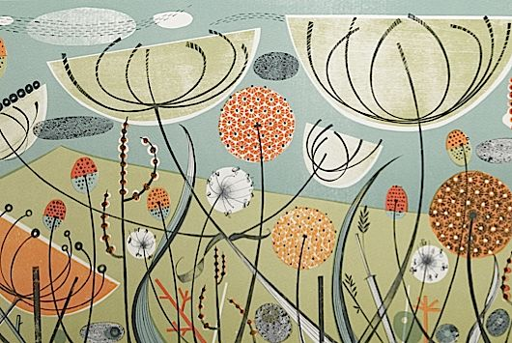
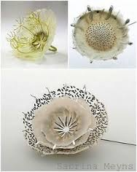
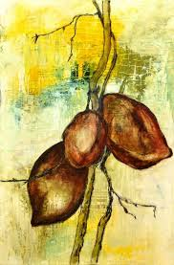
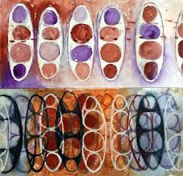
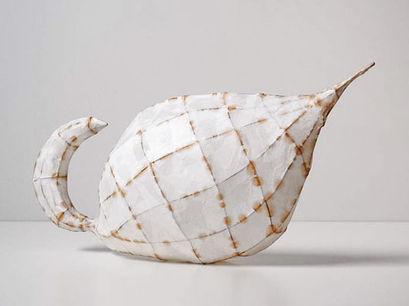
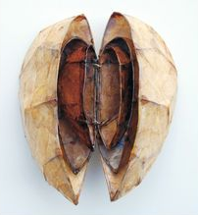
Organic Forms Project
Key Words & Definitions
Organic Forms | From the natural or living world. Irregular, free-flowing, curvy & not symmetrical
Nature | Shells, seed pods, plants, flowers, fruit,, leaves, sea life, insects
Seed pods | Plants that are members of the legume family like peas and beans
Composition | The arrangement of elements within a work of art
Surface texture | Refers to the way an object feels to the touch or looks as it may feel.
Experiment | Test the properties of different materials & how they might be used effectively in your work. Don’t be afraid to try new things!
Papier mâché | French for “chewed paper” and is a substance mixed from paper pieces and pulp and used to create 3d projects
Wire Art | The creation of sculpture /jewellery out of flexible wire to make 2d & 3d forms
Contour drawing | French word for outline. Drawing the basic outline of an object.
Artist Research Page
TWISBOQ
Title - Artist name
Writing - Artist info
Images – Artist images
Study – own copy of artist’s work
Background – creative & relevant to style
Opinion – own opinion of artwork
Quote – from the artist
Mindmap
An example of a visual moodboard of ideas on the theme using a collage of collected images
Annotation = written explanations that record your thoughts and explain the thinking behind an idea or analyse a technique
Artist links
Painting Vocabulary
Intensity | The brightness or dullness of a colour | Scumbling | Uses layers of small scribbled marks to build up texture
Opaque | Colours that you can’t see through | Bleeding | The action of one colour running into another
Translucent | Colours that you can see through | Tonking | A method of removing excessive paint by rubbing paper
Monochrome | A single colour and its tints and shades | Stippling | Applying small dots of colour with the point of a brush
Wash | Diluted paint or ink layer of colour | Sgraffito | Scratching or cutting through a layer of paint colour
Palette | A series of colours that you paint with | Dry Brush | A paint brush that is relatively dry & small amount of thick paint
Angie Lewin
Manok Cohen
Sabrina Meyns
Sophie Munns
Odine Lang

