Slide 1
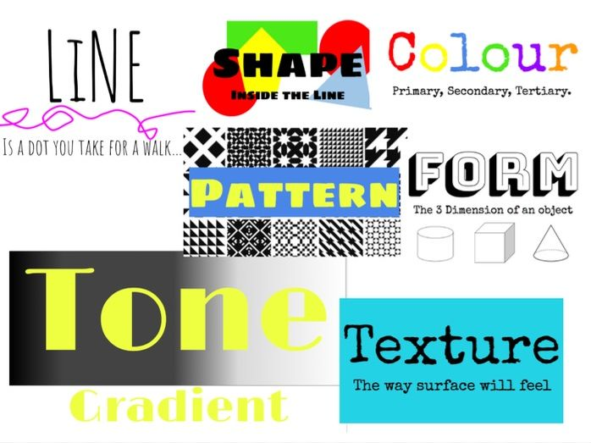
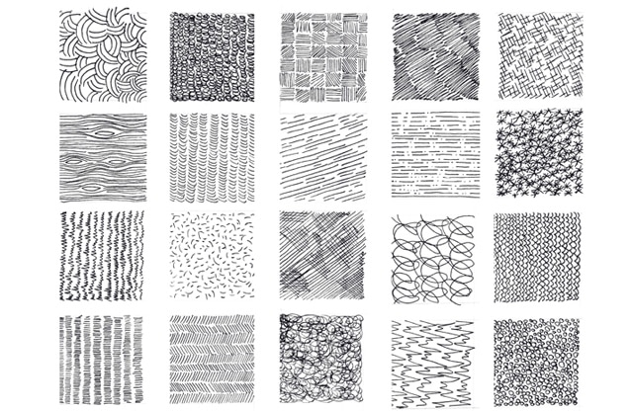
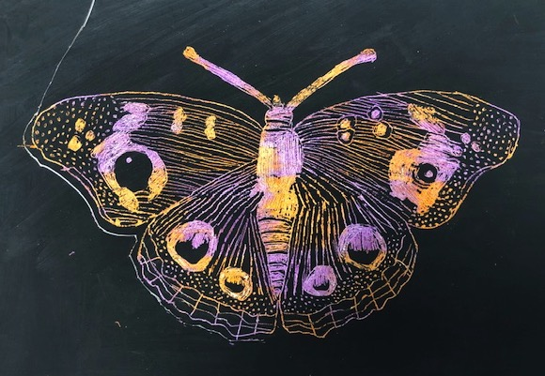
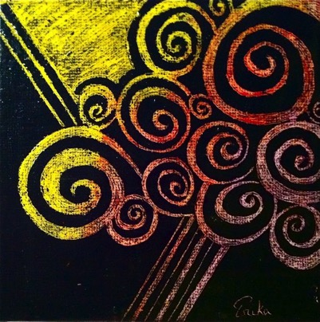
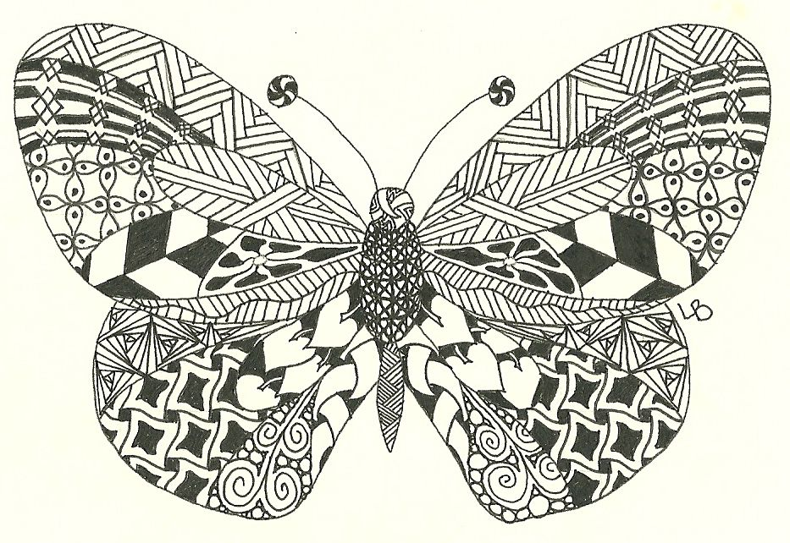
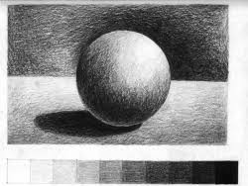
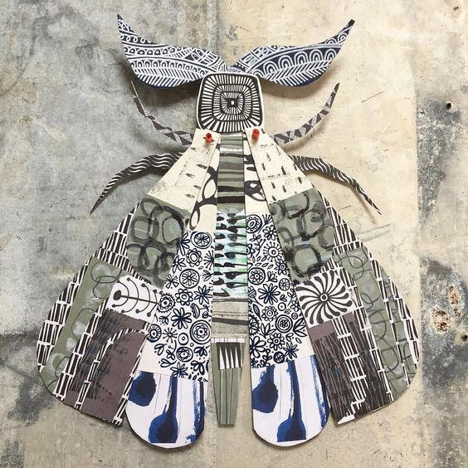
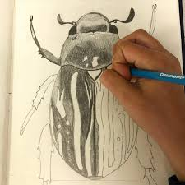
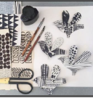
Y7 INSECTS PROJECT
The Formal elements of art are the building blocks used by artists to create a work of art.
Mark-making
To make your drawings look more realistic and interesting you should try to use different marks to show textures and surface qualities. You can do this by changing direction, pressure or length of your marks.
Sgraffito
This is an Italian word which means: “scratched”. It consists of putting down a base surface, covering it with another, and then scratching the top layer to reveal the bottom base colour using lots of different mark- making effects.
Italian g the top layer to
These are the knowledge & skills that you will need to know & use in your ‘INSECTS’ Project
What is a Zentangle?
Zentangle is a style of drawing, that uses repetitive patterns and represents an artistic method of relaxation for many.
Pencils come in different grades, the softer the pencil the darker the tone
H=Hard B=Black
In art the most useful pencils for shading are 2B & 4B to create a range of tones
Tonal Shading
To prevent your drawings from looking flat, you should use a range of tones from dark to light. Varying the pressure and layering your pencil creates different tones. Use the direction of your pencil to enhance the 2D surface, you can also use shadows which will make objects appear 3D.
Clare Young Artist - Paper Art Sculptures
Tonal shading example

Slide 2
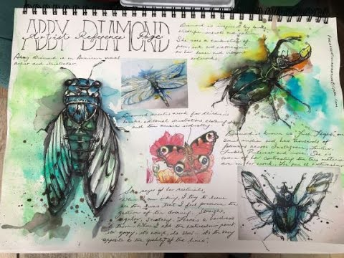
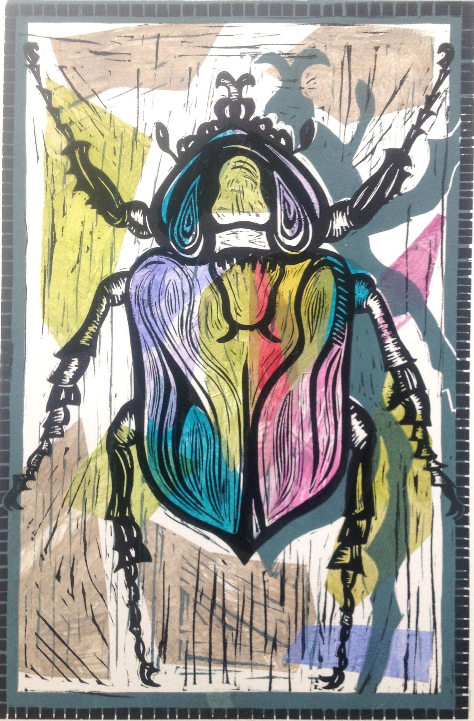
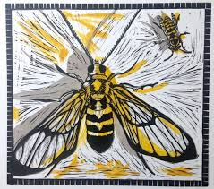
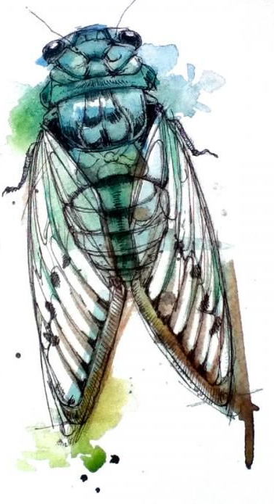
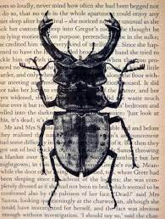
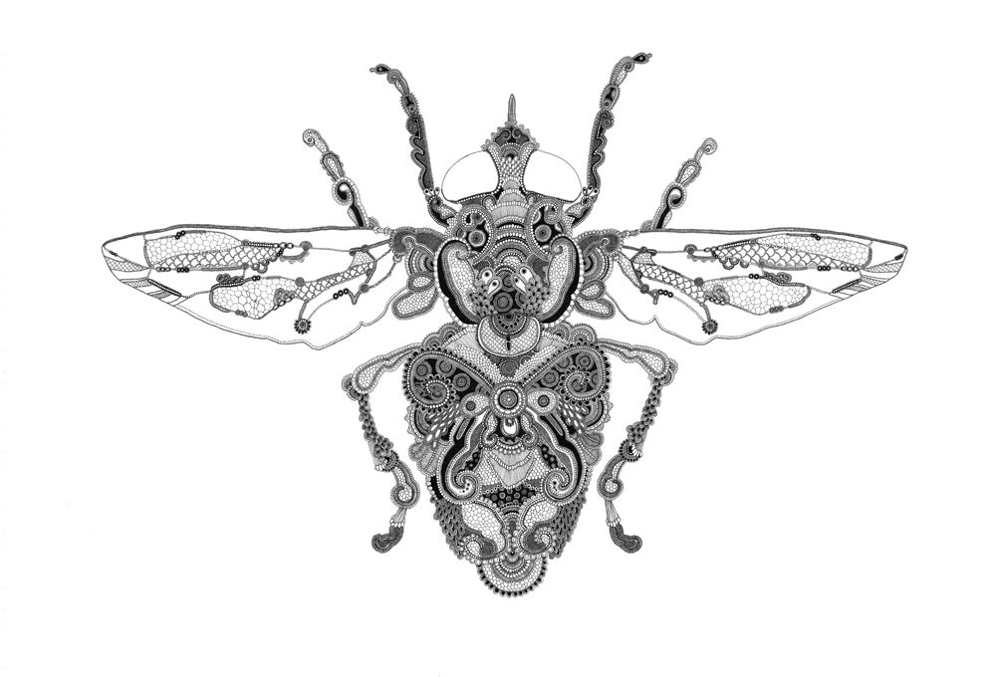
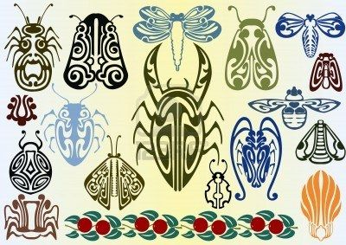
Y7 INSECTS PROJECT
Project Key Words & Definitions
INSECT | Any group of small animal having no backbone and 3 parts to the body
THORAX | This is the middle segment of the body. The 6 legs and 2 wings (if present) are attached to the thorax
ARTHROPOD | The scientific name for insects and spiders
ABDOMEN | This is the last of the 3 parts of the body
ANTANNAE | The antennae are a pair of sense organs located near the front of the insect’s head
EXOSKELETON | The hard covering on the outside of the insect that protects or supports the body
SWARM | A large group of insects all moving together
WINGS | Insects wings enable them to fly and are usually attached to the thorax. The 2 pairs are referred to as the for wings and hindwings
SEGMENTED | Insects have segmented body which means that it is divided. The 3 segments are the head, thorax and abdomen. The legs are also segmented.
MANDIBLE | A pair of appendages near the mouth used to grasp, crush or cut the insect’s food or to defend against predators
COLONY | Insects such as bees, ants or termites live together in groups called colonies. Millions may live in a single colony building a giant nest
COCOON | The silky enclosure spun by caterpillars that they live in whilst they are turning into adult insects
CHRYSALLIS | The stage of caterpillars, moths and other insects that is between the larva and the adult stage
HIVE | A structure where bees live, especially a beehive or the group of bees living there
SYMMETRICAL | If an object is symmetrical, It means it is equal on both sides
Artist Research Page
TWISBOQ
Title - Artist name
Writing - Artist info
Images – Artist images
Study – own copy of artist’s work
Background – creative and relevant to style
Opinion – own opinion of artwork
Quote – from the artist
An example of a successful Artist research page combining images & information
Annotation = written notes in sketchbook that record your thoughts & explain the thinking behind an idea or analyse a technique
Artist links
Joe Macgown
Alison Headley
Abby Diamond
Natalie McIntyre
Rosalind Monks
Art Nouveau

