Slide 1
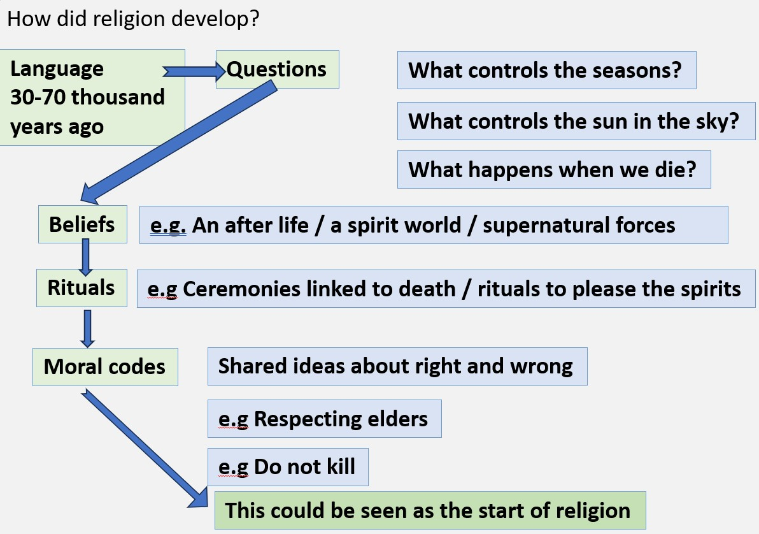
Unit: Comparative Religions Year: 7 Term: Winter Name:__________________________
Learning Question 1: How did religion develop?
Vocabulary: Theism: the believe that there is a God Atheism: the belief that there is no God Agnosticism: the belief that there is not enough evidence to say whether there is a God or not. Monotheism: the belief in one creator God Polytheism: the belief in many gods What is religion? Most people agree that religions have these three aspects: Beliefs (Things people believe are true) Example: A powerful creator God Practices (Things that people do because of their faith) Example: Celebrating festivals such as Christmas Moral codes/ ethics (rules about right and wrong) Example: Do not steal, Do not Kill (from The Ten Commandments) How did religion develop?
Learning Question 2: Where are religions practiced?
Vocabulary Persecuted: unfair or cruel treatment because of your beliefs or who you are. Census: compulsory questionnaire taken every 10 years to record important information about the UK population. Missionary: someone sent to other parts of the world to spread Christianity. Some facts and figures about religion 86% of the world's population are religious. A third of the world is Christian making it the worlds biggest religion. In 2015 there were 2.3 billion Christians in the world. This had risen to 2.5 billion by 2019 According to UK census data in 2011 there were 33 million Christians in UK (59% of the population) by 2021 this had fallen to 27million (46%) Islam is the second biggest religion (around 1.8billion) but the fastest growing. Where did the major faiths start? The major world religions developed in two parts of the world. Judaism, Christianity and Islam began in the Middle East. Hinduism, Buddhism and Sikhism began in India. How did they grow and change? Religion developed in several ways. Examples: Two thousand years ago Jews were persecuted by the Romans and so moved around the world. Some Muslims, Hindus and Sikhs moved to the UK as citizens of the British empire. Many arrived after the world wars to help rebuild. Christians sent missionaries around the world to spread Christianity. Some religions argued over leadership and beliefs causing them to split into different groups. E.g. Christianity disagreed over the leadership of the Pope in Rome this split Christianity. What is the future of Religion? More children are being born into religious families meaning the number of religious people is expected to grow. Christianity is expected to grow by 34% by 2060. Islam is expected to grow by 70% by 2060 By 2060 Christianity and Islam will be similar in number and will form two thirds of the worlds population. The UK, the USA and parts of Europe religion is declining.
Learning Question3: What is religion about?
Vocabulary World view: Different ways of understanding the world. These are influenced by many things such as up bringing, friends, religion country etc. What is religion? It is difficult to say exactly what religion is. In LQ1 we saw how most people agree that it is made up of beliefs, practices and moral codes. A man called Ninian Smart tried to identify what all religions had in common, and he found that they all shared seven things. Ninian Smarts Seven Dimensions of Religion Smart said that religions were like world views, ways of understanding the world. He said there were seven parts to a world view that could also be applied to religion. 1. Beliefs things that people believe are true Example: God created the world 2. Stories narratives and stories that teach or inspire believers. Example: Story of Adam and Eve in the Bible 3. Rules/ethics ideas about right and wrong Example: The Ten Commandments in the bible 4. Rituals things that people do regularly as part of their religion. Example: Pray before bed, celebrate festivals etc 5. Feelings things that people feel linked to their religion. Example: a sense of comfort from the presence of God, or joy at the celebration of a festival. 6. Social / groups different groups that share ideas and beliefs. Example: Roman Catholics are the biggest group in Christianity who follow the leadership of the Pope in Rome. 7. Material/ objects objects or items that belong to a religion. Example: A Bible, a church building, rosary beads etc.
Learning Question: 4 How do religions use symbols to express complex ideas?
Vocabulary: Symbol: simple ways of representing complex ideas. They are often images but can also be gestures, actions or stories. Pilgrimage: Journey made for religious reasons. Dharmachakra (Buddhism) Khanda (Sikhism) Cross (Christianity)
Represents the wheel of life, the 8 spokes represent the 8-fold path, the eight things' Buddhists should do achieve enlightenment.
The central sword is the khanda and represents the power and oneness of God. The two kirpans are a reminder of the earthy duties and spiritual duties of a Sikh. The circle, the chakkar is a reminder that God is eternal, no beginning and no end.
The empty cross is used by most protestant Christians who emphasise the resurrection of Jesus to save people from sin. The crucifix (cross with Jesus on) is often used by Catholics to remind them of Jesus’ suffering for their sins.
Symbols aren’t always images According to the Jewish Torah the Ten Commandments were written on stone symbolising how ‘weighty’ or important they are. People may join their hands when they pray to symbolize respect for God. Stories can have symbolic meanings. E.g Myths are stories that are untrue but can still have a powerful symbolic meaning. E.g. Rama and Sita / Adam and Eve Some Sikhs wear objects all beginning with K as a symbol of their faith. (5K’s)e.g. Kara a steel bangle; a reminder of God. On pilgrimage (Hajj) Muslims throw rocks at three pillars to symbolise rejecting evil.
1
2
3
4
5
6
7
Religion

Slide 2
Unit: Comparative Religions Year: 7 Term: Winter Name:__________________________
Learning Question 5: What are sources of authority?
Vocabulary: Source of authority: Religious texts, people, leaders or bodies responsible for guiding people on how to live. Primary: something that comes first or is the most important. Religions have ideas about God, how to live and the afterlife. These are usually found in sources of authority. Sacred texts or holy writings are some of the most important sources of authority for many religions. In some religions their religious leaders can also be sources of authority, for example the Pope for Catholics. When he speaks about an issue Catholics take this very seriously and reflect on his words. Some examples of sources of authority and their teachings about God and the afterlife
Learning Question: 7 What practices do the religions have in common?
Vocabulary: Religious practices: Ways that people express their faith. Things that people do because of their faith. Rites of passage: Big events in life often marked by religious ceremonies or rituals. E.g Birth of a new child, marriage, funerals etc. In addition to worship and prayer, members of religions often take part in other religious practices, these may include rules regarding food, fasting and clothes and pilgrimage. Religious also take part in celebrations and mark significant rites of passage.
Food: Some religions have laws about food. Food that is permitted in Judaism is known as kosher. Muslims have similar rules, food that is allowed is known as halal and many Hindus are vegetarian. Some foods have symbolic meaning, for example Christians have bread and wine which remind them of body and blood of Jesus.
Fasting (going without food) for a period of time is common in religion. Many believe it teaches them self-control and reminds them of what it would be like for the poor. Muslims fast during daylight hours of Ramadan and some Christians eat less during Lent; the lead up to the most important Christian festival Easter.
Pilgrimage a journey to a place special to a faith. Muslims go to Makkah where Muhammad lived, some Christians may go to the Holy Land, to feel closer to Jesus, seeing where he lived, taught and died.
Religion | Source of authority | Teachings about God | Teachings about the afterlife
Judaism | The Tenakh, made up of three sections the Torah is the most important section as it contains Gods law or commandments. | One creator God that created humans to rule over the earth. | Jewish people believe in an afterlife though they are not sure what it is like.
Christianity | The Bible, made up of two sections, Old Testament and New Testament. Parts of the Old Testament also make up the Jewish Torah. | One God but he can exist in three different ways. God the Father (creator) the Son (Jesus) and the Holy Spirit. (Invisible force of God on earth) This is known as the Trinity. (3 in 1) | Christians believe that there is an afterlife with God. Many believe that for good people this will be in heaven.
Hinduism | The Vedas are the primary (main) source of authority, they contain ancient teachings about the universe. The smriti are secondary scriptures containing human ideas about how to live a good life. | God exists in many different ways, God is in everything and everything is God. | Hindus’s believe in reincarnation. They believe that once life is over their soul will be reborn into another living being.
Sikhism | The Guru Granth Sahib (a book) is treated as if it is a living Guru (Teacher) It has all the important teachings from the human gurus who were important leaders in the early part of the Sikh religion. | There is one God, he created everything and there is a spark of God in all living things. | Sikhs believe in reincarnation.
Celebrations religions celebrate many different things, important events such a Christmas and Easter for Christians, and big life events such as births, marriages and deaths. These are known as Rites of Passage ceremonies.
Learning Question: 8 Does religion matter?
Vocabulary: Secular: not having any connection to religion, a secular celebration is a celebration that does not include religious aspects.
Evidence that religion is still important Even though traditional religion is losing some of its appeal, 86 percent of the world's population are religious. Religion is still very important in much of the Middle East and Latin America and Africa. By 2060 two thirds of the worlds population with be Muslim or Christian. These faiths are growing. Evangelical Christians were largely responsible for electing Donald Trump. They are a very large and powerful group. Religion offers people hope and comfort especially at times of need and loss. E.g. Belief in an afterlife helps deal with the loss of a loved one. Religious organisations often fight for human rights and run charities. Christianity has heavy influence on UK life, e.g, holidays (Christmas / Easter), pop music, (Stormzi) Food (Fish on Friday) Assembly in schools usually include a prayer etc. | Evidence that religion is losing importance In the UK, the number of people saying they have no religion is growing. From 15% in 2001 to 37.2% in 2021 Even though many people in the UK celebrate Christmas and Easter, many do so in a secular (non-religious) way. For many people science provides many of the answers that religion used to provide. E.g How the universe began. One of the biggest charities fighting for human rights around the world is Amnesty international and that is a nonreligious organisation. There is evidence that in the UK, much of Europe and in the USA the influence of religion is decreasing. Schools in the UK often ignore the law for a daily act of worship, ‘broadly Christian’ in nature.
Learning Question 6: How do religious people express their faith?
Vocabulary: Worship: is any act that shows devotion or love for God. E.g Praying or going to a place of worship. Morality: a personal sense of what is right and wrong. Someone’s morality is somtimes influenced by their faith and its teachings. People can express their faith in several ways. These include, communal/public worship, private worship and in their morality.
Communal worship: worship in groups Important for a number of reasons, You can connect with others Strengthens faith by sharing with others May feel Gods presence more in groups. May believe prayers are more powerful in groups. May feel communication with God is stronger through organised rituals. | Private/individual worship: People may also worship alone, they may; Reflect or meditate on God Study their religion or read a source of authority alone. Share personal thoughts with God out loud or in their head. May say private prayers. One form of worship is not better than another, many will feel both have their place and are valuable. | Morality (ideas about right and wrong) If you believe that God created everything, they treating Gods creation with love, respect and compassion can be an expression of faith or an act or worship. In the Ten Commandments, six of them are about morality. Religions all teach that actions should be motivated by love, compassion, generosity, honesty, forgiveness, respect for life and others.

