Slide 1
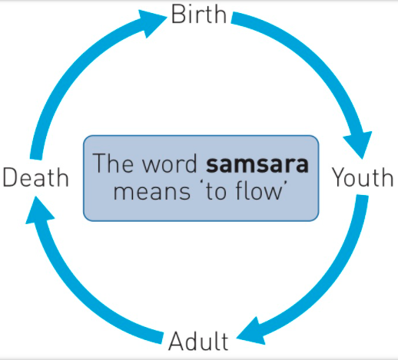
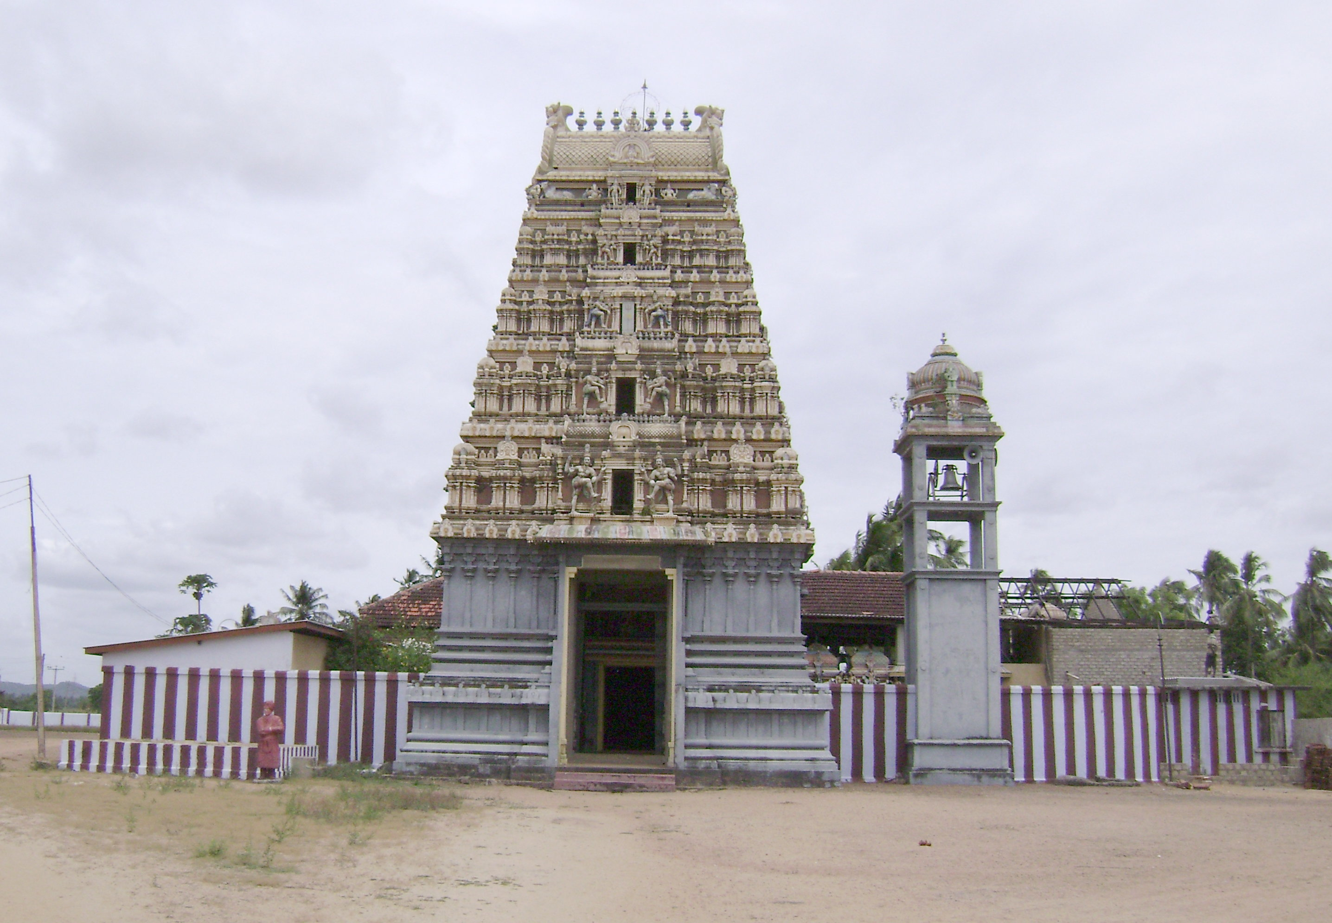
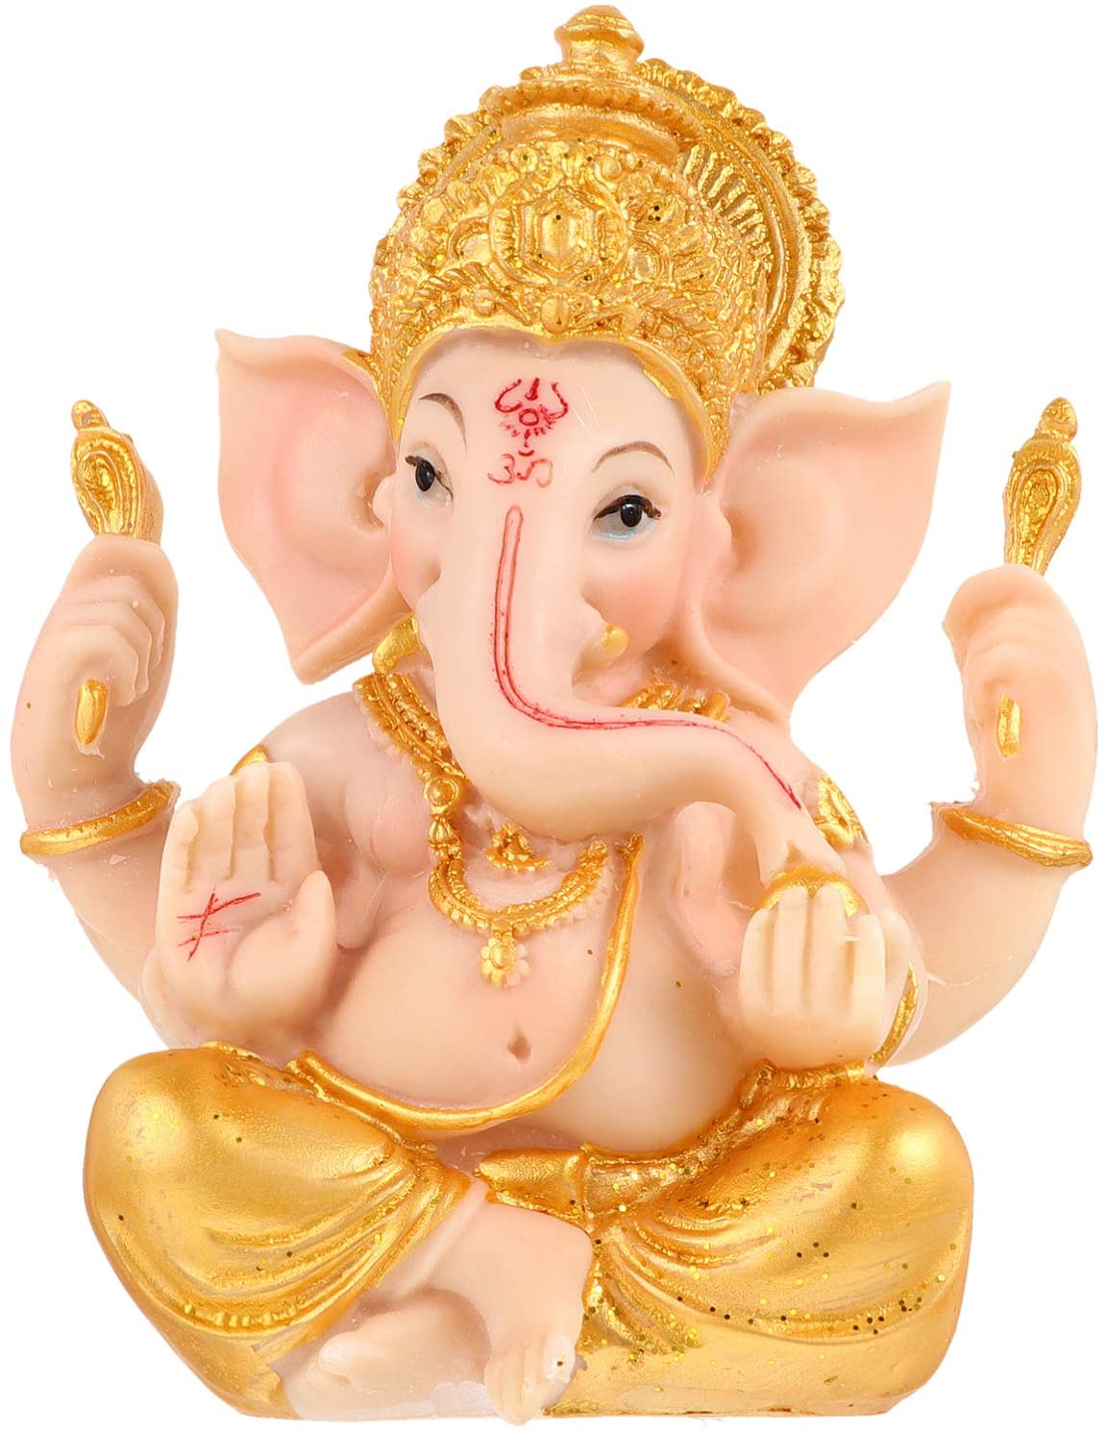
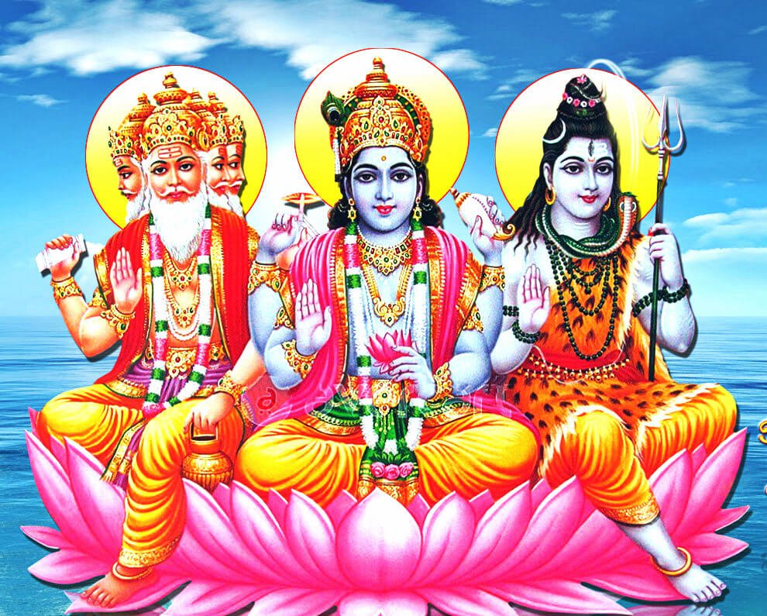
Unit: Hinduism Year: 8 Term: Winter Name:__________________________
Learning Question 1: How do Hindu’s understand God
Vocabulary: Deity: a character that represents an aspect of God e.g Ganesh (see below)
Learning Question 2: How does belief in karma and rebirth influence a Hindu's morality?
Vocabulary Morality: a personal sense of what is right and wrong. Someone’s morality is often influenced by their faith and its teachings.
Learning Question 3: How do scriptures inspire Hindu’s?
Vocabulary Source of authority: Religious texts, people, leaders or bodies responsible for guiding people on how to live. Primary: something that comes first or is the most important.
Learning Question: 4 What are the main features of a Hindu mandir?
Vocabulary: Mandir: Hindu temple/place of worship
Hinduism developed in India and is one of the oldest world religions
There are different ways of understanding God in Hinduism.
One God Brahman
Some focus on the idea of One God, Brahman, the One Ultimate Reality.
God is beyond human understanding; he is limitless and too powerful for humans to understand or see.
Brahman is everywhere and in everything.
Some think of God’s many qualities.
Some use images to help them focus on one quality of God. Characters that represent an aspect of God are called deities. For example, Ganesh is the aspect of God that removes obstacles. (Elephant headed deity) Images or statues of these deities are known as murti’s.
Hindu Scriptures (holy writings)
All religions have holy books. They are sources of authority.
They offer guidance, hope and inspiration for people.
Some of them are incredibly old written in languages that are not even spoken anymore making exact translations difficult.
Some of the Hindu holy books are almost 5000 years old.
There is usually a gopuram at the entrance which is a tall carved tower decorated with images of deities.
Garba griha- main shrine. There will be a murti (statue) of the main deity being worshiped in the centre. Often garlands of flowers, fruit and incense are left as offerings to the deity.
Around outside of the main shrine are sometimes smaller shrines to different deities. Hindus will often say prayers and light ghee lamps (oil lamps using clarified butter as oil) in front of the shrines.
Each shrine will have a bell next to it that people ring to announce their presence to the deity.
A Priest will lead services in the temple
One of the key beliefs in Hinduism is the idea of Samsara, the cycle of birth, death and rebirth. (reincarnation)
Sruti/shruti (heard and seen)
These are the primary (most important) scriptures that were ‘heard and seen’.
Many believe that wise and holy men known as sages received the words from Brahman (God).
The shruti contain the oldest Hindu texts the Vedas.
The Upanishads are part of the Vedas and contain the central ideas and beliefs about Hinduism.
Karma
All actions have consequences. People can choose to create good karma by doing good deeds and bad karma by doing bad deeds.
Only humans can create karma because only they can make moral decisions, other animals act out of instinct.
Hindu’s believe we carry the karma from one life to the next, being rewarded or punished depending on our karma.
Eventually when we have worked through all our karma we can achieve moksha and our atman will return to God.
Smirti (remembered)
These are things people were told about God, they were remembered and written down by people.
They include great stories called epics, that give religious teachings.
These stories all help Hindus understand the primary scriptures (sruti) better.
Story of Holika and Prahlad
There was once a demon king who demanded everyone worship him.
His son Prahlad refused because he was a loyal follower of Vishnu (preserver in the Trimurti)
The king tried to kill Prahlad several times but failed. Each time Vishnu saved him.
The king's sister Holika had a special blessing, she could not burn in fire.
The king asked Holika to lure Prahlad to sit in her lap before lighting a fire underneath her, thinking she would not burn.
The blessing switched onto Prahlad and Holika burned to death.
Prahlad was saved by Vishnu as a reward for his loyalty.
What does this story teach Hindu’s?
That good wins over evil
Loyalty and devotion to Brahman (God) is rewarded
Evil will be punished
A warning about how people can be manipulated to do evil.
How people should use their skills for good not evil. (Holika tried to use her blessing to kill Prahlad)
Hindus’s are inspired by these stories to live good lives, worship Brahman and get closer to Moksha. (See LQ2)
Images of God
Hinduism is one of the world’s oldest religions existing before humans had written language.
Images were used to help people understand what God was like.
Stories were then told about these images showing Gods different qualities.
They make it easier for people build a relationship with.
Gopuram: Tall carved tower found at the entrance to many mandirs.
Purpose of life (Moksha)
Hindu’s believe we have an atman (soul) this is reincarnated many times over and over according to the law of Karma.
The aim of life is to break free from the cycle of reincarnation (samsara) and for our atman to join with Brahman (God).
This is called Moksha.
How does karma and rebirth influence a Hindu’s morality?
All actions create karma, good actions- good karma.
Hindus want to have a positive rebirth and so will try to do good in their life.
Hindu’s may treat people with love and compassion.
They be generous and give to others/charity.
They may pray and show devotion to brahman through worship.
They may practice ‘Ahimsa’ (not harming) living things an may we vegetarian.
Hindu’s may be discouraged from doing bad things because they do not want to create bad karma and get punished in the next life.
Learning Question 5:How do Hindu's worship in a mandir?
Vocabulary: Worship: is any act that shows devotion or love for God. E.g Praying or going to a place of worship. Types of worship in the mandir: Puja: worship of a deity. This can take different forms. The murti (image or statue of the deity) will be washed and dressed by priests. Offerings are often made of flowers garlands, fruit and water and prayers or mantras are chanted and incense is burned. Arti: worship of a deity involving light/flame. The deity is greeted with offerings moved in a circular motion . A bell is rung whilst people meditate (think about) the deity. A priest brings a tray with an arti lamp on it, and the worshipper waves their hand over the flame then over their heads. They then take back some of the flowers and sprinkle water on themselves. Kirtan (stories) and hymns are sung. Hindu’s believe that the lamp becomes filled with the love and energy of the deity and this is transferred to them.
A murti of Ganesh
Trimurti
As God is too great to understand some Hindus break Brahman up into the Trimurti meaning ‘three forms’
Brahma Creator
Shiva-Destroyer
Vishnu–Preserver

Slide 2
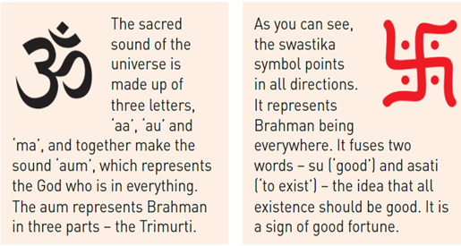
Unit: Hinduism Year: 8 Term: Winter Name:________________________________
Learning Question 6: How do Hindu’s worship at home?
Hindu’s have a duty to worship every day. Some go to the Mandir every day but for many this is not possible and so it is very common for Hindu families to have a shrine at home., that way every day can start with an act of worship. What happens during home worship? Families often have a shrine at home with a chosen murti in the centre. The mother or grandmother leads the worship, she ensures she is wearing clean clothes and the room is clean. She pours water over the murti (image/statue) and dresses it with garlands and clothes. The woman places a coloured paste on the murti and on the foreheads of her family. This is a tilak and is a sign that the family have worshiped that day. Puja and arti is also performed. (See LQ 5)
Learning Question: 7: What are the main stage of life for a Hindu?
Learning Question: 9: How do Hindu’s try to live a good life?
Vocabulary: Virtues: Positive values or principles that are seen as important by people trying to live good moral lives. E.g Truth, tolerance, compassion. Brahman (God) is in all living things. This means that Hindus value life and living things. In order to show respect for life Hindus believe they should develop virtues. The virtues The Hindu scriptures (See LQ 3) mentions several virtues they include; Ahimsa (non-harming, non-violence) Compassion (loving kindness) Service to others Tolerance Honesty with yourself and others Cleanliness Wisdom Respect for life Self-discipline Providing shelter / support to others Many of these virtues are connected, Example Ahimsa is not harming other living things, self-discipline may also be needed because occasionally we may feel we want to lash out, so self-control is needed to avoid causing harm. (Ahimsa) Many Hindus also respect animal life, they are often vegetarians, after all if Brahman is all living things, he is also in animals. Human life is considered the highest form of life because they have the ability to choose to be good moral people and get closer to Brahman. If they focus hard on becoming the best they can be, eventually they may break free from the cycle of samsara (birth and rebirth see LQ2) . They will stop being reincarnated and their atman (eternal spirit/soul) can join with Brahman which is their ultimate goal.
Learning Question 10 How do Hindu's celebrate festivals ?
Ancient Hindu texts describe someone’s life as being split into four stages or ashramas. Most modern Hindus only do the first two.
1. Student stage (Brahmacharya)
This is the young stage of life when someone is learning.
Boys often have a sacred thread ceremony called upanayana. During this stage Hindus are taught discipline and respect.
2. Householder stage (grihasthra)
This is when it is expected that Hindus will get married, have children and earn their wealth.
Many modern Hindu’s do not go further than this stage.
3. Retirement stage (vanaprastha)
Once the family is fully grown, then a Hindu may begin the retirement phrase. They should start give up all physical, material and sexual pleasure and retire ‘to the forest’ In the UK Hindus generally take on the grandparent role and stay on as respected elders to advise younger generations.
4. Renunciation stage (Sannyasa)
This is a full commitment to achieving moksha. All material things and links to this life are given up. Traditionally a sannyasin would be wandering and living alone off the land. Many do not ever reach this stage even after many lives. Only those fully dedicated come close. This stage is more common with worshippers of Shiva (Shaivites)
Holi: Festival of colour
What: Remembers the story of how Vishnu saved the life of a follower, Prahlad from a burning fire.
The second day remembers Krishna (an avatar/form of Vishnu who has blue skin) gently painting Radha (a girl he loved) face blue because she was conscious of her skin being a different colour. Krishna is known as a prankster and mischievous, so the day is often filled with fun and mischief.
When: Spring
How is it celebrated?
Bonfires are lit with figures of Holika placed in them. Holika dies in the story in the fire intended to kill Prahlad.
Cards and gifts are exchanged with family and friends.
Second day Rangoli Holi- people meet up in public places and throw coloured powder around on to people.
Music, singing and dancing.
Diwali: Festival of Light
What: The story of Rama rescuing Sita from the evil ten headed demon Ravana. Good winning over evil, light overcoming darkness.
When: November
How is it celebrated?
Lighting of diya/diva lamps, bonfires and fireworks.
Houses are cleaned/ best clothes.
Special foods are eaten and friends and family visit.
Rangoli patterns on doorsteps to welcome Lakshmi goddess of wealth.
Why do many Hindu’s start the day with worship at home?
Sets a good example for children in the home.
Starting the day by thinking of God sets their minds on the right track for a good day.
Helps them to face the challenges of the day.
Helps to keep their minds focused on good actions and working on good karma for a better rebirth.
Families often choose a deity to focus on, Ganesh is popular as he removes obstacles and brings good luck.
Having a shrine at home feels like God is always present in the house.
Learning Question 8: What do the Aum and swastika represent for Hindu’s
The swastika is an ancient symbol linked to good fortune.
Due to the Nazi use of it in the 20th Century for many it is linked with the hatred and murder of Jews known as the holocaust.
Whilst the Nazi version and the ancient Hindu versions can look different, they can also look very similar, and they can get confused.
Some Hindus was to reclaim this as their own symbol and try and remove the negativity surrounding it.
For others, especially Jews, it will always be linked to an awful event in their history.
‘The story behind the festival is what makes it great’
Agree | Disagree
Stories make it memorable and give it meaning. | The activities are the most enjoyable for most people
We learn the stories as children and pass them down to the next generation. | Bringing people together as a community is what makes festivals great!
The stories have meaning and morals to teach. E.g Good winning over evil Like Rama and Sita defeating the ten headed demon Ravana | Many festivals in the UK have become very secular (non-religious) but people still love them. The story is not as important.

