Slide 1
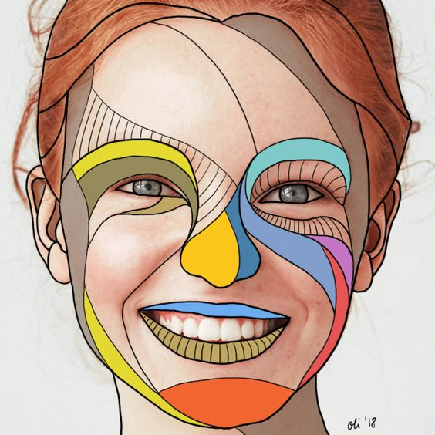
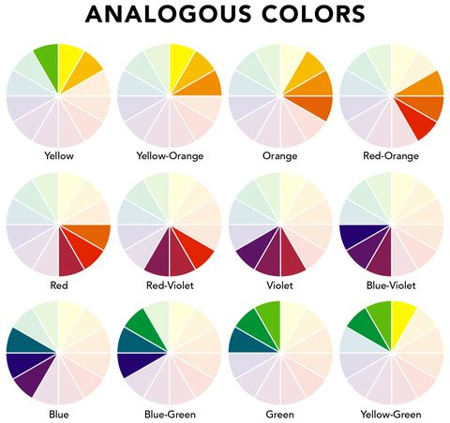
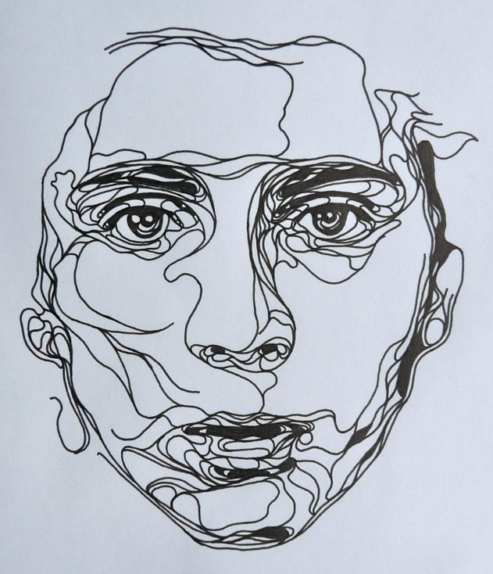
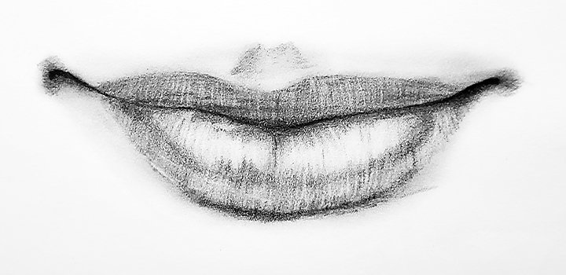
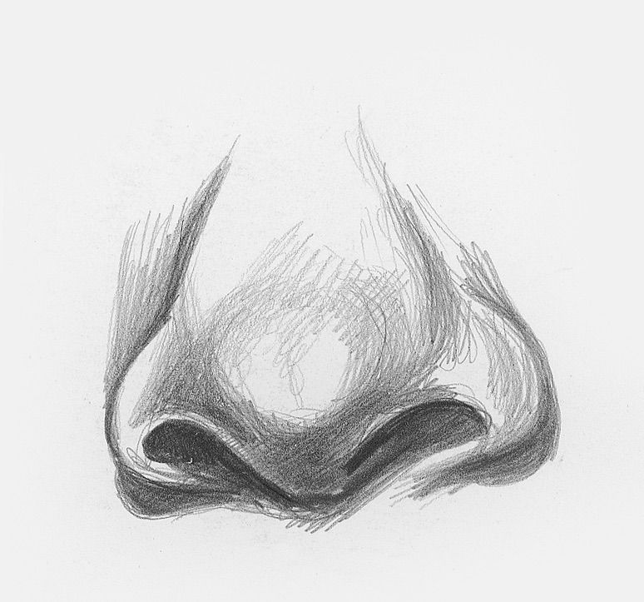
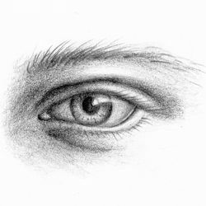
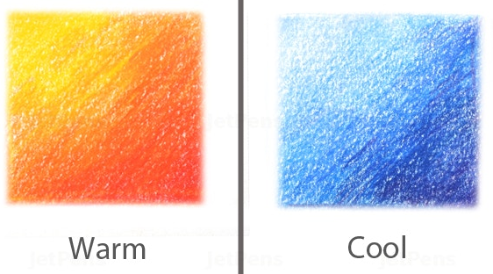
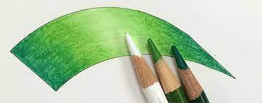
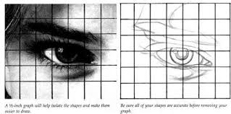
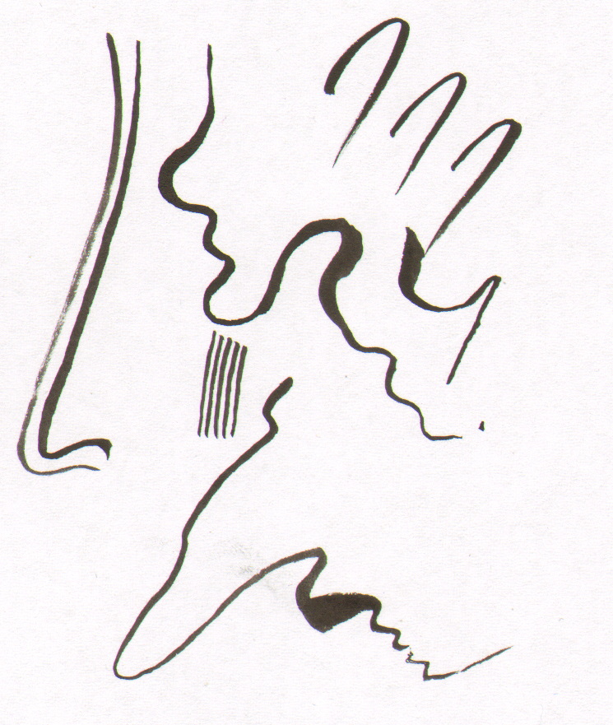
Y8 PORTRAITS
What is a Portrait?
A painting, drawing, sculpture or photograph of a person especially one depicting only the face or head and shoulders. The intent is to display the likeness, personality and mood of the person.
Contour is the outline or shape of something. Contour comes from the Italian contorno meaning "to draw a line," which is precisely what you are doing when you trace the contour of something
Face proportions
These are the knowledge & skills you will need to know & use in your ‘PORTRAITS’ Project
Eye line
(middle)
Colour Vocabulary
Harmonious – Colours from the same section on the colour wheel & blend well together
Nose line
What is a continuous line drawing?
A single unbroken line is used to create the image – the trick is not to take your pen off the paper!
Mouth line
Blending Coloured Pencil
Keep your pencils sharp
Use the lightest pressure you can
Use fine circular motions
Change direction regularly
Use harmonious colours as these blend well together to create a seamless effect
.
Facial features
The Grid Method = draw 1 square at a time
The Formal Elements of Art
LINE | A mark which can be long, short, wiggly, straight etc. The foundation to a drawing.
TONE | Tone is the lightness or darkness of something. Used to make 2D look 3D
SHAPE | A shape is an area enclosed by a line. They can be geometric or irregular.
PATTERN | A design created by repeating lines, shapes, images & colours
TEXTURE | Describes the surface quality of something; e.g rough or smooth
COLOUR | Colour is what you see when the light reflects off something. Red, yellow and blue are the 3 primary colours used to make all other colours.
What does the weight of a line mean?
How thick or thin it is: Varying the line weight makes objects more 3D and interesting, adds value, dimension, weight, and emphasis
Formal Elements of Art
COLOUR LINE TONE
TEXTURE SHAPE PATTERN
FORM

Slide 2
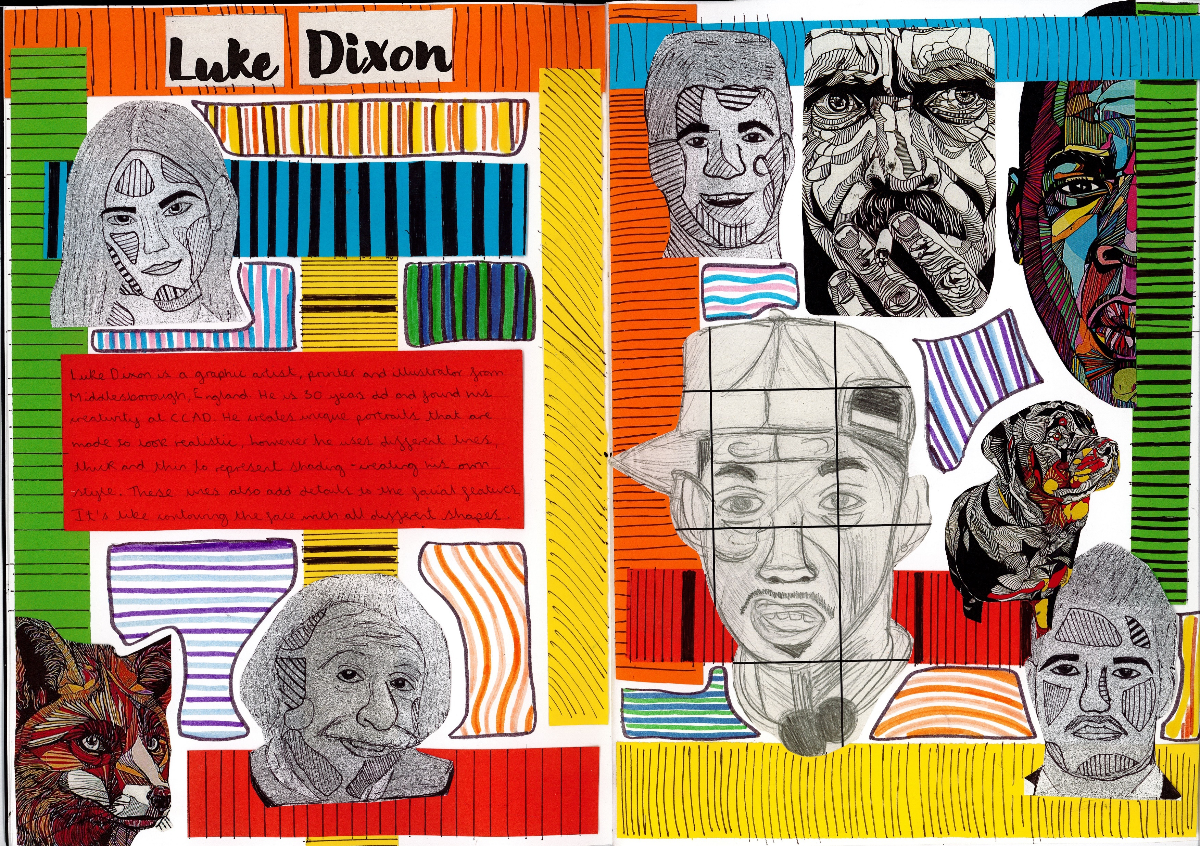
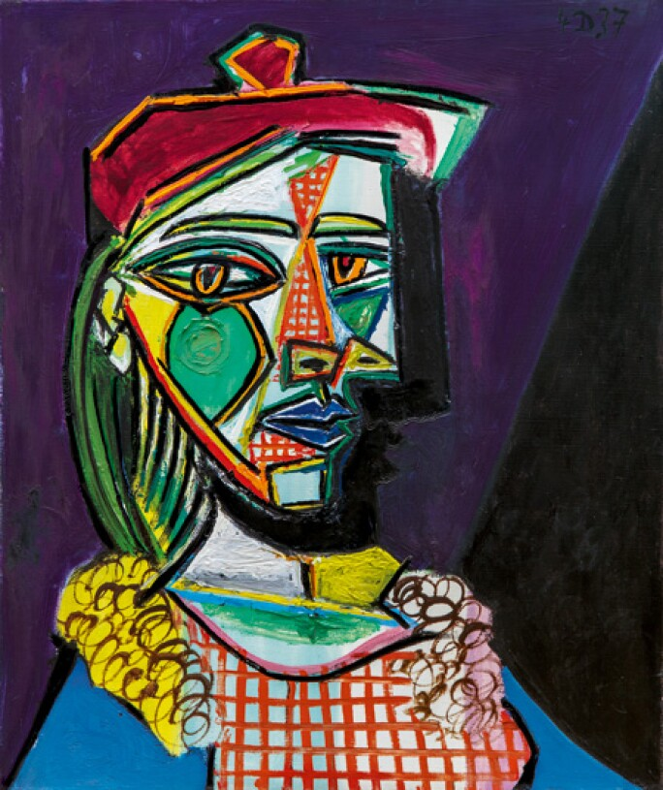
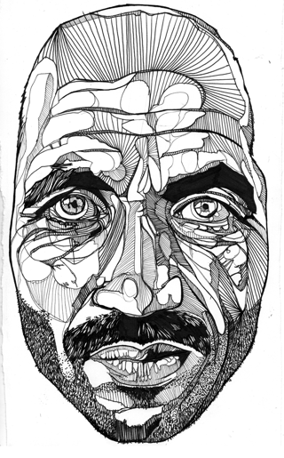
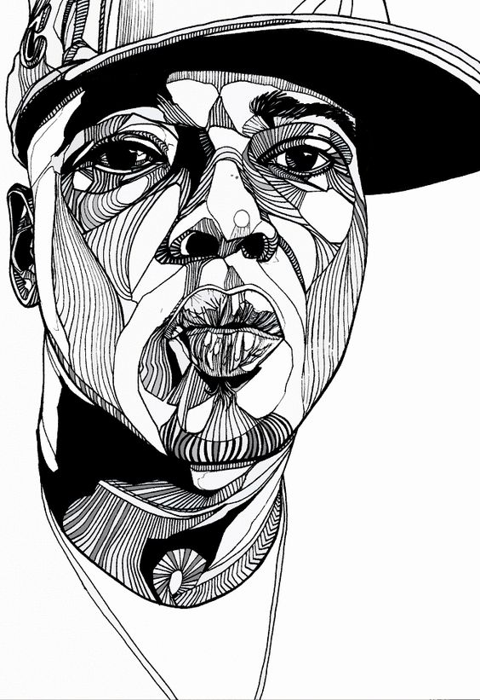
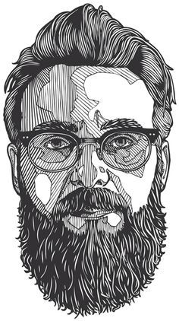
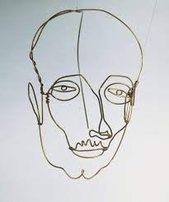
Y8 PORTRAITS PROJECT
Key Words & Definitions
Proportion | Proportion refers to the relative size of parts within a whole. In this case, the whole can be a single object like a person's face.
Self-portrait | A portrait of the artist by the artist themselves
Features | These are typically eyes, nose, mouth, ears (the senses). These can also be unique features i.e. freckles or a scar.
characteristics | Traits of a persons i.e. friendly, chatty
Line drawing | A drawing done using only narrow lines, without blocks or shading
Mixed media | A piece of art made using which more than one medium or material. This could be a combination of painting, photography, collage, textiles.
Mark-making | Used to make your drawings look more realistic and to show textures and surface qualities. You can do this by changing direction, pressure or length of mark.
Blending | The action of mixing or combining colours together
Graphic art | the visual arts based on the use of line and tone rather than three-dimensional work or the use of colour.
Irregular shapes | An irregular shape is a shape which has sides and angles of any length and size.
Sketch | A drawing that is done quickly without lots of the finer details
Continuous line | The line in a single line drawing to make the image and is unbroken from the beginning to the end.
Abstract | Abstract art is art that does not attempt to represent an accurate depiction of a visual reality but instead use shapes, colours, forms and gestural marks to achieve its effect.
Profile | profile means the side view or something which can be observed partially or from a side.
Artist Research Page
TWISBOQ
Title - Artist name
Writing - Artist info
Images – Artist images
Study – own copy of artist’s work
Background – creative & relevant to style
Opinion – own opinion of artwork
Quote – from the artist
An example of a successful Artist research page combining images & information
Annotation = written notes in sketchbook that record your thoughts & explain the thinking behind an idea or analyse a technique or artist
Artist links
Picasso
Alex Calder
Luke Dixon

