Slide 1
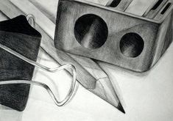
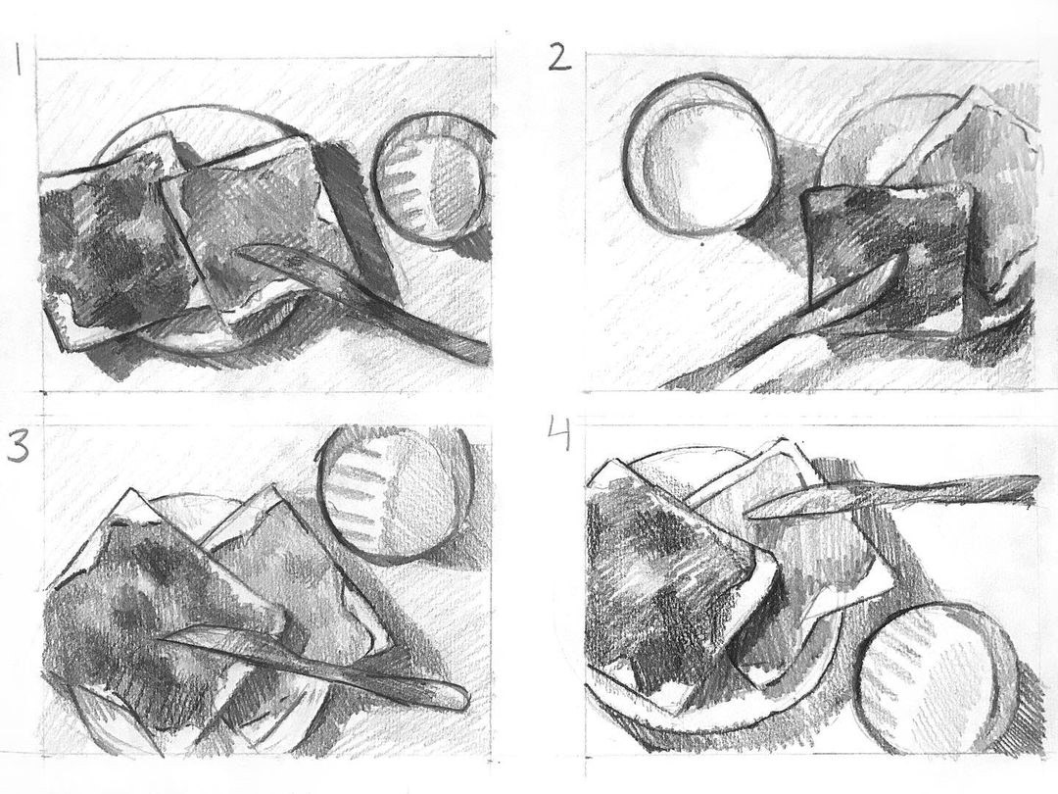
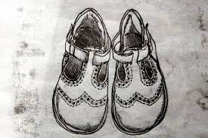
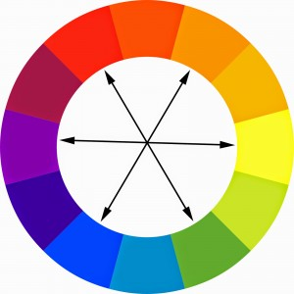
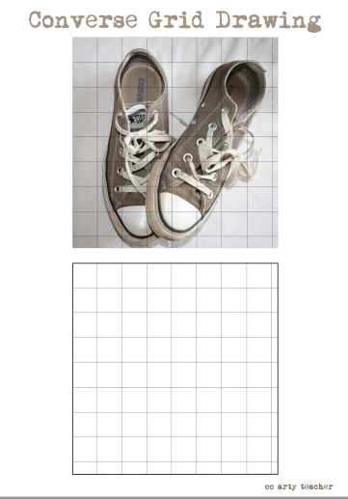
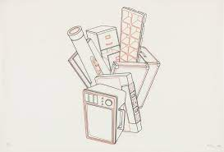
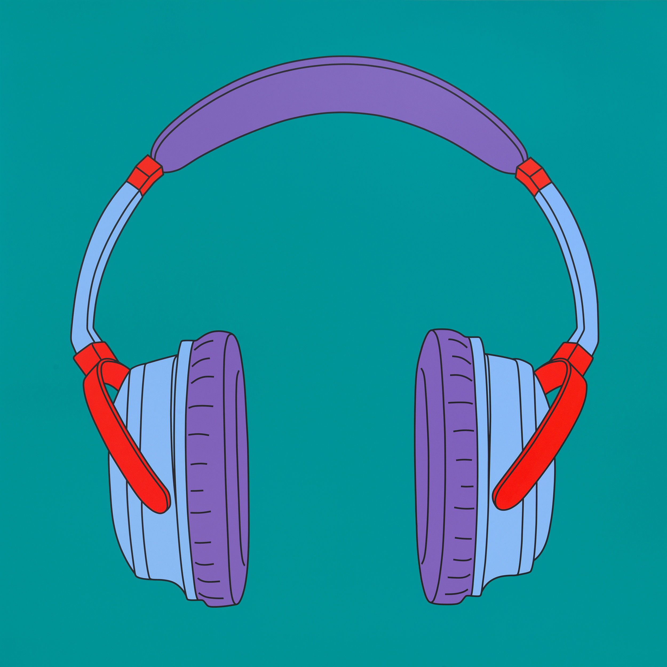
Y9 Everyday OBJECTS
Composition
Composition is the arrangement or placement of visual elements in a piece of artwork.
Observational Drawings
Observational drawing is drawing what you can see directly in front of you, sometimes known as from a primary source
Monoprinting
A technique which is known as the most painterly among printmaking as it is essentially printed painting. It has lines and images that can only be made
once = MONO
.
These are the knowledge & skills that you will need to know & use in ‘The Everyday Objects’ Project
Colour Vocabulary
Complimentary Colours – Pairs of colours opposite each other on the colour wheel and when placed next to each other make each other appear brighter and more vibrant
Line Drawing
Grid Drawing Method
A drawing done exclusively in line, providing gradations in tone entirely through variations in width and density (no colour, tone or texture)
Translucent & Opaque Paint effects
Translucent
letting light through.
Seeing through to the other side.
Less rich in colour
Add more water to the brush.
Opaque
not letting light through
Hard to see through
more rich in colour
Add more paint to the brush
Method = Draw one square at a time
Key Terms
Media | The substance that artists use to make artwork
Materials | The same as media but it can include the basis for artwork eg canvas, paper, clay.
Processes | The creative journey of what you do to develop your artwork from beginning to end.
Techniques | The method, procedure or way that something is done eg drawing, painting or printing are all different techniques
Design | A plan for the construction of an object or the preliminary planning to solve any problems
Refine | To make small changes which improve the idea in some way. Adapt, modify, transform or correct your work.
Pop Art style
Formal Elements of Art
COLOUR LINE TONE
TEXTURE SHAPE PATTERN
FORM

Slide 2
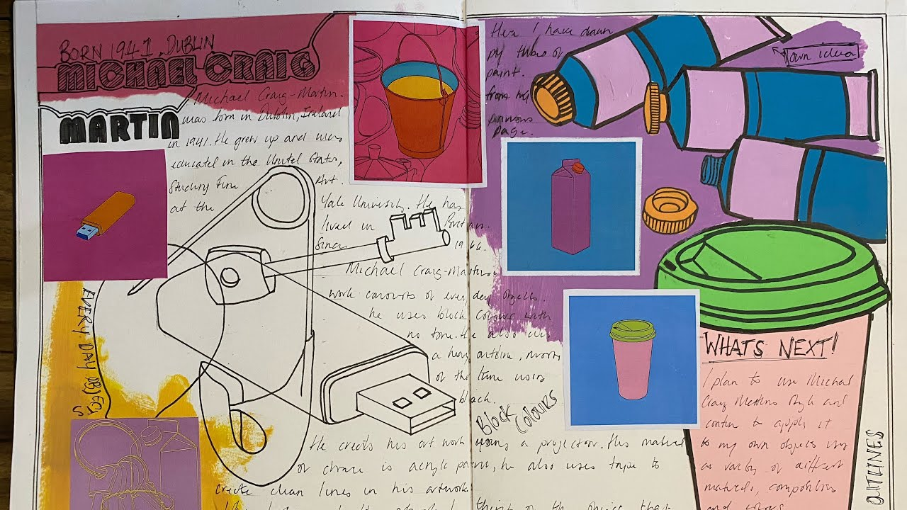
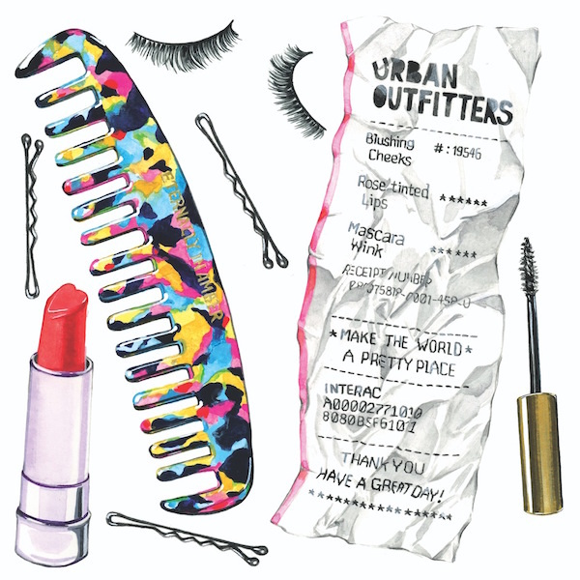
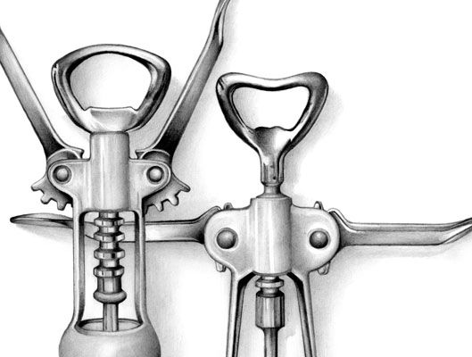
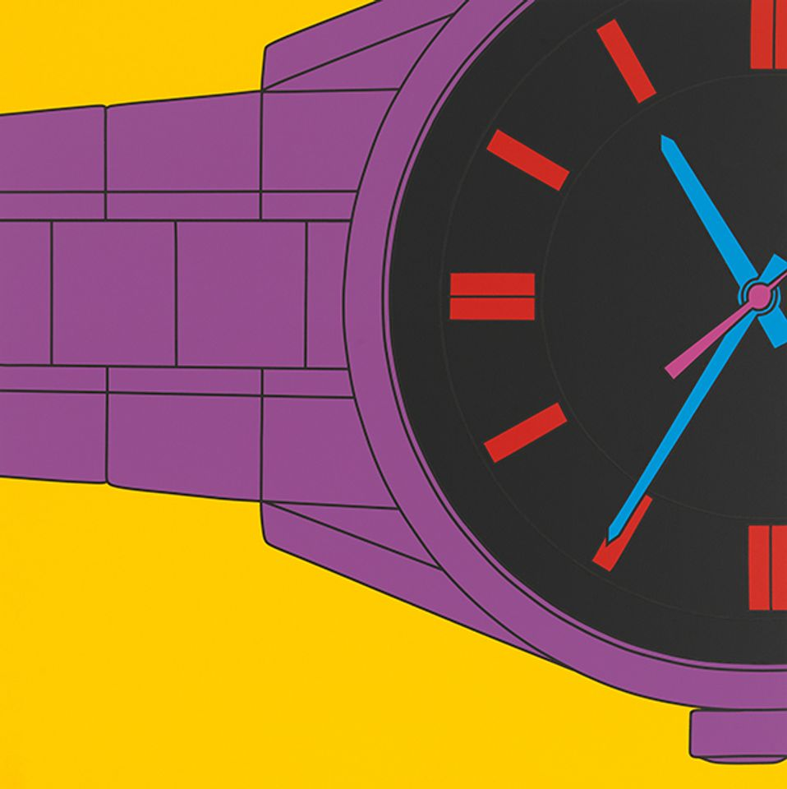
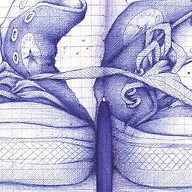
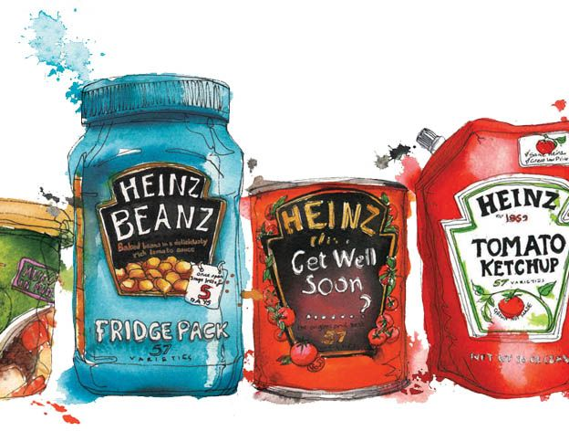
Y9 Everyday Objects
Key Words & Definitions
Acrylic Paint | A plastic, water soluble pigment used for painting. This gives a smooth opaque effect
Balance | The art principle which refers to the arrangement of elements in an art work. Balance can be either formal symmetrical, informal asymmetrical or radial.
Colours | An element of art that refers to "hue“ (colour name) “intensity” (the brightness) and “Value” (light or dark)
Colour wheel | The organisation of colours on a wheel. Used to help understand colour schemes.
Composition | The arrangement or placement of the parts of a work of art
Design | From the Italian word meaning "drawing" which also implied planning and composing
Drawing | Representations on a flat surface usually made with pen, pencil, crayon, chalk or paint with an emphasis on line
Line | An element of art used in drawing, painting and sculpture. A line is the path of a moving point.
Shape | The element of art that describes a two-dimensional area (height and width).
Pop Art | Art based on modern popular culture and the mass media, especially as a critical or ironic comment on traditional fine art values. What is fashionable/popular in society
Vivid | An intensely deep or bright colour
Garish | Bright, ‘show-off’, loud colours
Everyday Objects | The word mundane can be appropriate here, as it can be used to refer to things that are common or ordinary or not very special
Artist Research Page
TWISBOQ
Title - Artist name
Writing - Artist info
Images – Artist images
Study – own copy of artist’s work
Background – Creative & relevant to style
Opinion – own opinion of artwork
Quote – from the artist
Annotation = written notes in sketchbook that record your thoughts & explain the thinking behind an idea or analyse a technique or artist
Careers in Art
What can I be?
Interior designer
Architect
Illustrator
Art therapist
Photographer
Tattoo artist
Animator & lots more!
Artist links
Janice Wu
Cath Riley
Michael Craig-Martin
Andrea Joseph
Georgina Luck

